Slide 1
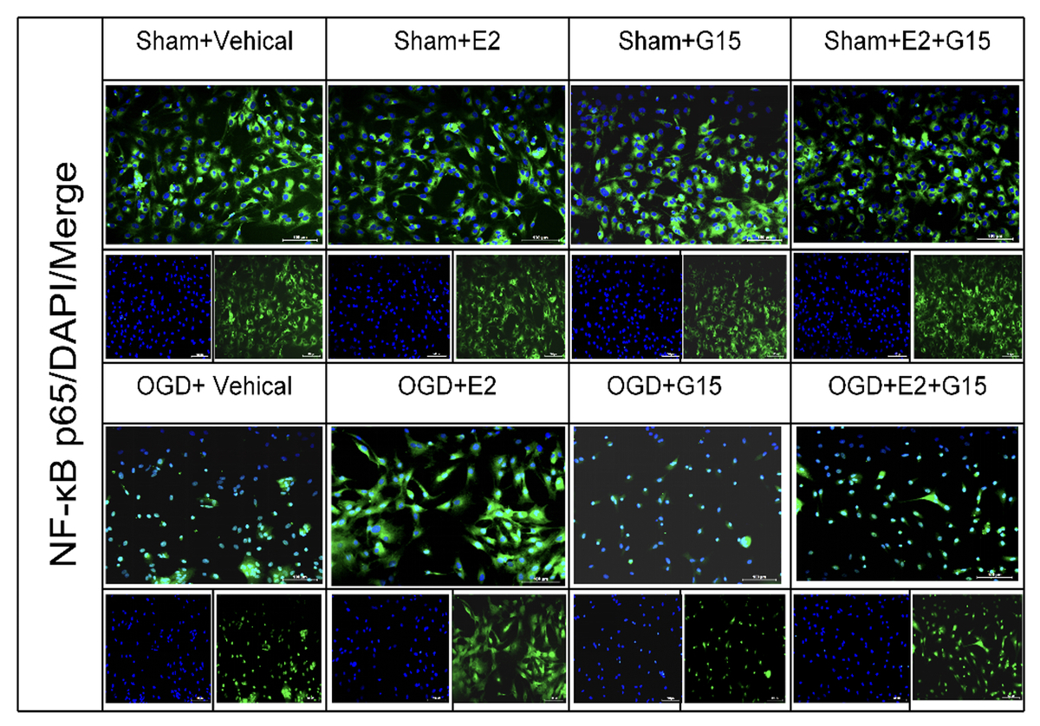

β-estradiol alleviates hypoxic-ischemic brain damage in neonatal rats through the GPER1-mediated AKT/NF-κB signaling pathway
DOI: 10.5114/aoms/192051
Arch Med Sci 2025;21(4):1612-1630
Notes:
Introduction
Research has established that estradiol (E2) offers neuroprotection against hypoxic-ischemic brain damage (HIBD) in neonatal rats, yet the underlying mechanisms are not fully understood. This study sought to determine whether E2’s neuroprotective effects in neonatal HIBD are mediated through astrocytes by modulating G protein-coupled estrogen receptor 1 (GPER1) and the subsequent AKT serine (AKT)/nuclear factor-κB (NF-κB) signaling cascade.
Material and methods
We developed an in vivo HIBD model in neonatal rats and established primary cultures of astrocytes subjected to oxygen-glucose deprivation-reoxygenation (OGD-R) as an in vitro model. E2 and the GPER1 inhibitor (G15) were administered according to the experimental
design. Protein expression levels of GPER1, phosphorylated AKT (p-AKT), NF-κB p65, and cleaved caspase-3 were examined using Western blot analysis. Apoptosis was assessed via the TUNEL assay, and the presence of tumor necrosis factor-α (TNF-α) and interleukin-1β (IL-1β) in the cell supernatant was quantified by ELISA. The localization of p-AKT and NF-κB p65 was determined through immunofluorescence.
Results
Our findings indicate that E2 treatment significantly reduced the volume of brain infarction and astrocyte apoptosis. E2 upregulated GPER1 and p-AKT expression while downregulating NF-κB p65 and cleaved caspase3 levels in astrocytes and neonatal rats after HIBD. Additionally, E2 diminished the secretion of TNF-α and IL-1β in the cell supernatant. The G15
inhibitor notably reversed the neuroprotective effects of E2 and the associated molecular changes.
Conclusions
These results suggest that E2 may provide neuroprotection in neonatal rats with HIBD by inhibiting astrocyte apoptosis and modulating the expression of GPER1, p-AKT, and NF-κB, thereby providing a potential therapeutic strategy for HIBD.

