Slide 1
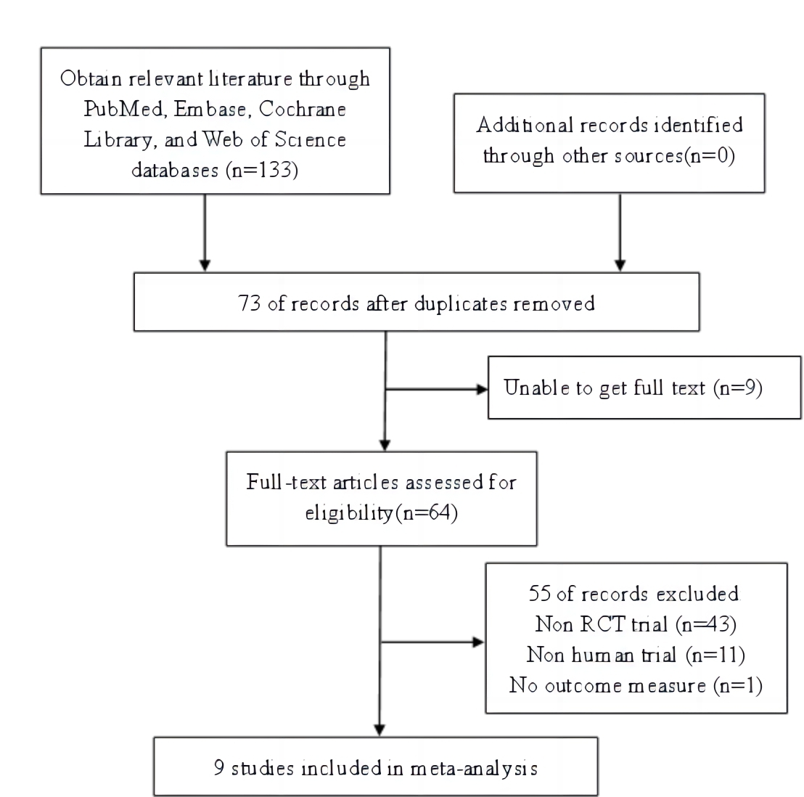

Efficacy and safety of proton pump inhibitors for diabetes mellitus in patients with gastroesophageal reflux disease: a meta-analysis
DOI: 10.5114/aoms/192052
Arch Med Sci 2025;21(5):1956-1964
Notes:
Introduction
Gastroesophageal reflux disease (GERD) is prevalent in patients with type 2 diabetes mellitus (T2DM). The use of proton pump inhibitors (PPIs) is recognized as an effective method to reduce gastric acid secretion in patients with GERD. Nevertheless, whether PPIs are effective or safe for the treatment of T2DM complicated by GERD remains unknown.
Material and methods
To assess the efficacy and safety of PPIs in the management of T2DM complicated with GERD, databases including Web of Science, Cochrane Library, PubMed, and Embase were comprehensively searched for randomized controlled trials (RCTs) focusing on the treatment of T2DM complicated with GERD published before December 2023. Following data extraction and quality assessment, outcomes, including endoscopic efficiency, fasting blood glucose (FBG), symptom relief rates, levels of glycosylated hemoglobin A1c (HbA1c), and the incidence of adverse reactions, were analyzed using RevMan 5.4.
Results
The results suggest that the PPI group exhibited a higher efficacy rate compared to the control group in endoscopic efficiency (69.32% vs. 5.45%, OR = 40.50, 95% CI: 18.77–87.39) and symptom relief rates (92.94% vs. 54.65%, OR = 6.45, 95% CI: 3.41–12.20). Furthermore, PPI treatment was associated with a significant reduction in HbA1c levels (weighted mean difference [WMD] = –0.41, 95% CI: –0.68 to –0.14) and FBG levels (WMD = –10.15 mg/dl, 95% CI: –19.64 to –0.66) in patients with T2DM complicated with GERD. In terms of safety, the incidence of adverse reactions was not significantly different between the two groups (PPI group: 10.78% vs. control group:11.88%, p > 0.05).
Conclusions
PPIs can effectively improve the glycemic control of patients with T2DM complicated with GERD.

