Slide 1
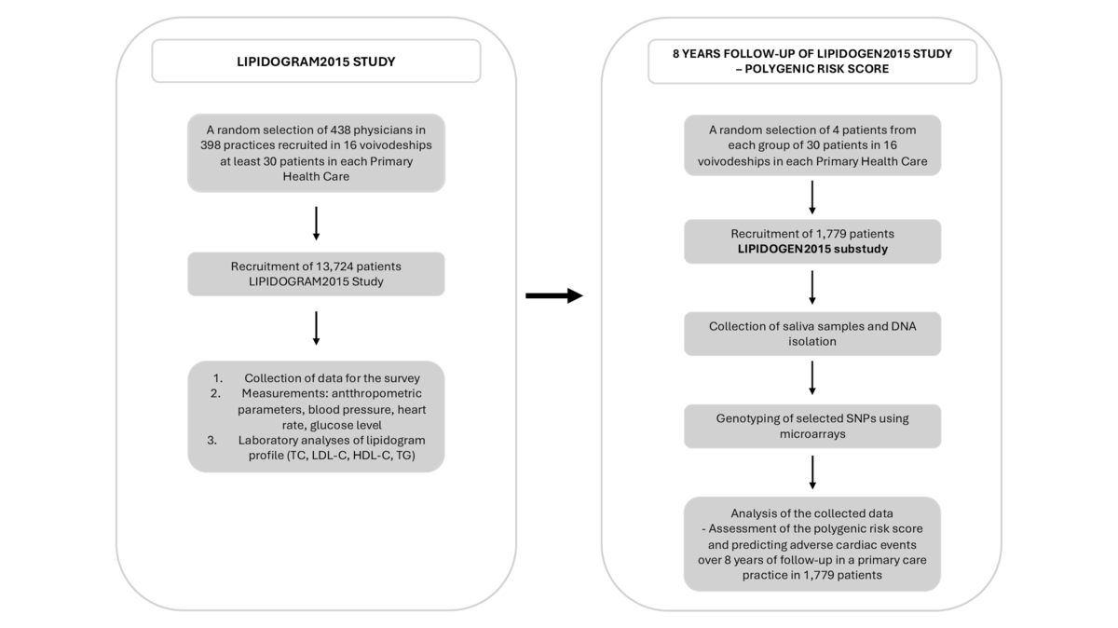

Risk of adverse cardiovascular events based on common genetic variants in 8-year follow-up of the LIPIDOGEN2015 population using the polygenic risk score (PRS): study design and methodology
DOI: 10.5114/aoms/192147
Arch Med Sci 2024;20(5):1452-1460
Notes:
Introduction
Classical risk factors such as hypertension, hypercholesterolemia, pre-diabetes, diabetes and obesity can predict adverse cardiovascular events, but they are less prognostic in patients aged < 60 years. Polygenic risk scores (PRS) can be effective in predicting adverse coronary events in younger and middle-aged patients. Our main aim is to assess the utility of a new PRS created for the Polish population in predicting mortality during an 8-year follow-up in the nationwide LIPIDOGEN2015 population.
Material and methods
All DNA samples of 1779 patients were genotyped using Infinium Global Screening Array-24+ v3.0 Kit microarrays. The samples were amplified, fragmented, and hybridized to BeadChips. The BeadChips were scanned using iScan and converted to genotypes using Genome Studio 2.0.
Results
We will develop a PRS based on the identified single nucleotide polymorphisms (SNPs) in the LIPIDOGEN2015 project’s studied population and determine the analyzed group’s risk of death due to cardiovascular diseases (CVD) based on data obtained from 8 years of patient-follow-up. Using the developed PRS scale and biochemical analyses, we will assess the effectiveness of lipid-lowering therapy with statins in patients with high and low genetic risk of sudden CVD events (secondary endpoints).
Conclusions
The developed PRS scale, combined with clinical covariates, will facilitate the creation of an algorithm to predict long-term mortality. This will enable us to stratify CVD risk more precisely, which may result in earlier implementation of lifestyle changes and dietary adjustments and potentially initiate earlier pharmacotherapy for at-risk individuals.

