Slide 1
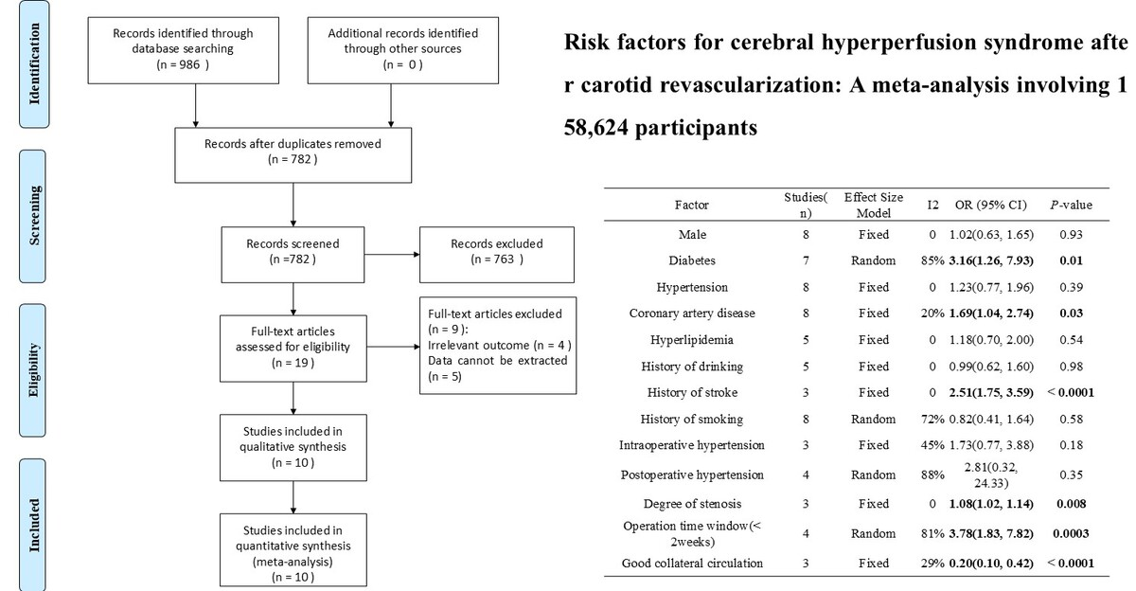

Risk factors for cerebral hyperperfusion syndrome after carotid revascularization: a meta-analysis involving 158,624 participants
DOI: 10.5114/aoms/192177
Arch Med Sci 2025;21(5):1974-1984
Notes:
Introduction
This study aimed to identify the risk factors associated with cerebral hyperperfusion syndrome (CHS) following carotid revascularization.
Material and methods
Comprehensive searches of the Cochrane Library, PubMed, Embase, Web of Science, CBM, CNKI, VIP, and Wanfang databases yielded potentially eligible studies published up to April 30, 2024. We conducted a meta-analysis using RevMan 5.3.
Results
Our analysis incorporated ten studies, encompassing 158,624 participants. The results demonstrated that diabetes (OR = 3.16, 95% CI (1.26, 7.93), p = 0.01), coronary artery disease (OR = 1.69, 95% CI (1.04, 2.74), p = 0.03), a history of stroke (OR = 2.51, 95% CI (1.75, 3.59), p < 0.00001), degree of stenosis (OR = 1.08, 95% CI (1.02, 1.14), p = 0.008), and an operation time window of less than two weeks (OR = 3.78, 95% CI (1.83, 7.82), p = 0.0003) constituted risk factors for CHS following carotid revascularization. Conversely, robust collateral circulation served as a protective factor (OR = 0.20, 95% CI (0.10, 0.42), p < 0.0001). Other factors such as male gender (OR = 1.02, 95% CI (0.63, 1.65), p = 0.93), hypertension (OR = 1.23, 95% CI (0.77, 1.96), p = 0.39), hyperlipidemia (OR = 1.18, 95% CI (0.70, 2.00), p = 0.54), prior alcohol consumption (OR = 0.99, 95% CI (0.62, 1.60), p = 0.98), smoking history (OR = 0.82, 95% CI (0.41, 1.64), p = 0.58), intraoperative hypertension (OR = 1.73, 95% CI (0.77, 3.88), p = 0.18), and postoperative hypertension (OR = 2.81, 95% CI (0.32, 24.33), p = 0.35) showed no significant association with post-revascularization CHS.
Conclusions
This investigation elucidated the risk and protective factors for CHS after carotid artery revascularization. Further research and clinical application will aid in refining strategies for the prevention and management of CHS.

