Slide 1
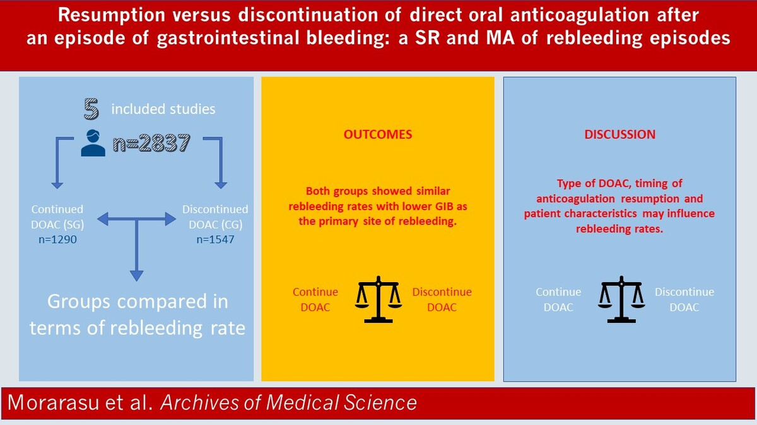

Resumption versus discontinuation of direct oral anticoagulation after an episode of gastrointestinal bleeding: a systematic review and meta-analysis of rebleeding episodes
DOI: 10.5114/aoms/192240
Arch Med Sci 2025;21(5):1965-1973
Notes:
Introduction
Direct oral anticoagulants (DOACs) have become standard of care in long-term anticoagulation. Extensive research has focused on this new class of drugs that, despite their benefits, have an associated risk of bleeding with lack of evidence for management following an episode of gastrointestinal bleeding (GIB). Our meta-analysis and systematic review provide an updated perspective on the rate of rebleeding in patients with an episode of GIB while on DOACs.
Material and methods
A systematic search of PubMed, Embase and Cochrane databases was performed for all comparative studies examining outcomes in patients who resumed versus withheld DOACs after a baseline episode of GIB. The initial search found 1823 studies. After excluding duplicates and unrelated studies based on abstract triage, 29 full texts were assessed for eligibility, out of which five matched the inclusion criteria and were systematically reviewed.
Results
Five studies containing data comparing clinical outcomes between patients were included. All studies were retrospective, including a total of 2837 patients, with a case control design. Both groups showed similar rebleeding rates with lower GIB as the primary site of rebleeding. Type of DOAC, timing of anticoagulation resumption and patient characteristics may influence rebleeding rates.
Conclusions
Considering the overall risk/benefit ratio of anticoagulation after GIB, our findings suggest a potential benefit for oral anticoagulation continuation. Further large-scale studies are needed to provide optimal management strategies in this population.

