Slide 1
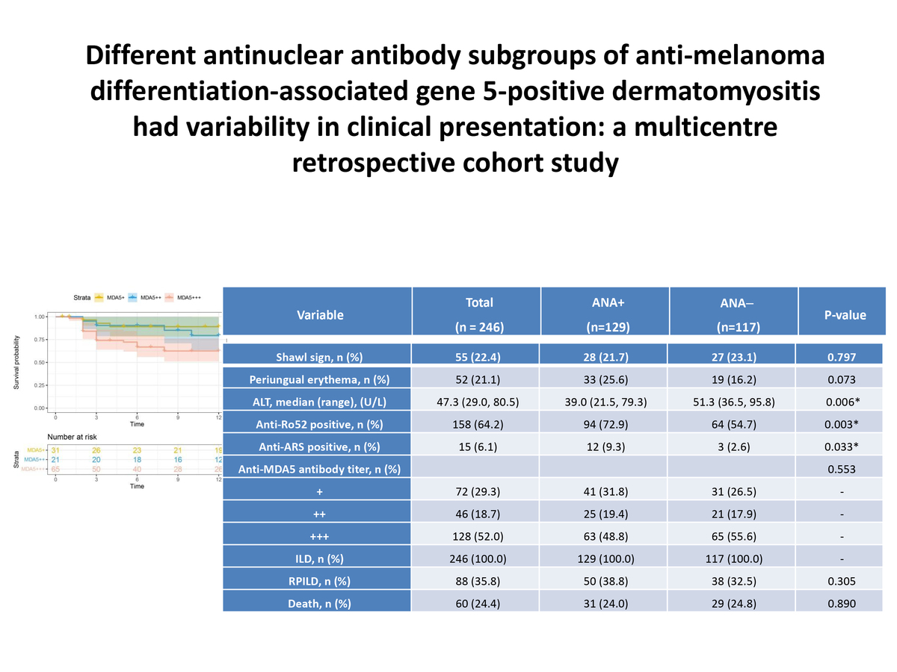

Different antinuclear antibody subgroups of anti-melanoma differentiation-associated gene 5-positive dermatomyositis showed variability in clinical presentation: a multicenter retrospective cohort study
DOI: 10.5114/aoms/192272
Arch Med Sci 2025;21(4):1345-1353
Notes:
Introduction
Antinuclear antibodies (ANA) are frequently positive in patients with anti-melanoma differentiation-associated gene 5-positive dermatomyositis (anti-MDA5+ DM). This study aimed to investigate the association between ANA and clinical characteristics as well as prognosis in a cohort of patients with anti-MDA5+ DM.
Material and methods
We conducted a systematic retrospective study of medical records from a Nanjing Medical University cohort of patients with myositis-associated interstitial lung disease (ILD). Various parameters were compared and analyzed between the ANA-positive group and the ANA-negative group.
Results
A total of 246 patients with anti-MDA5+ DM were enrolled in this study, with 28.5% males and 71.5% females. The median age was 53.0 years, the median disease duration was 2 months, and the median follow-up period was 12.0 months. The ANA positivity rate at baseline was 52.4% in anti-MDA5+ DM patients. The ANA-positive group showed significantly higher positivity rates of anti-Ro52 antibodies (72.9% vs. 54.7%, <i>p</i> = 0.003) and anti-aminoacyl-tRNA synthetase (anti-ARS) antibodies (9.3% vs. 2.6%, <i>p</i> = 0.033) compared to the ANA-negative group, but lower ALT levels: 39.0 (21.5, 79.3) vs. 51.3 (36.5, 95.8), <i>p</i> = 0.006. No significant differences were observed between the two groups in terms of overall survival, rapidly progressive interstitial lung disease (RPILD) incidence, age, disease duration, and clinical characteristics. In a subgroup analysis of the ANA-positive group, MDA5+++ patients had a higher incidence of RPILD compared to the MDA5+ group (<i>p</i> = 0.028). In the ANA-negative subgroup analysis, MDA5+++ patients had a higher mortality rate and worse prognosis compared to the MDA5+ group (<i>p</i> = 0.026). Multivariate Cox regression analysis showed that elevated lactate dehydrogenase (LDH) levels and the presence of rapidly progressive interstitial lung disease (RPILD) were associated with poor prognosis in ANA-negative anti-MDA5+ DM patients, with hazard ratios of 1.002 (95% CI: 1.001, 1.003, <i>p</i> = 0.020) and 13.694 (95% CI: 15.032, 37.267, <i>p</i> < 0.001), respectively.
Conclusions
ANA is frequently found in patients with anti-MDA5+ DM. High titers of anti-MDA5 antibodies are associated with mortality and RPILD.

