Slide 1
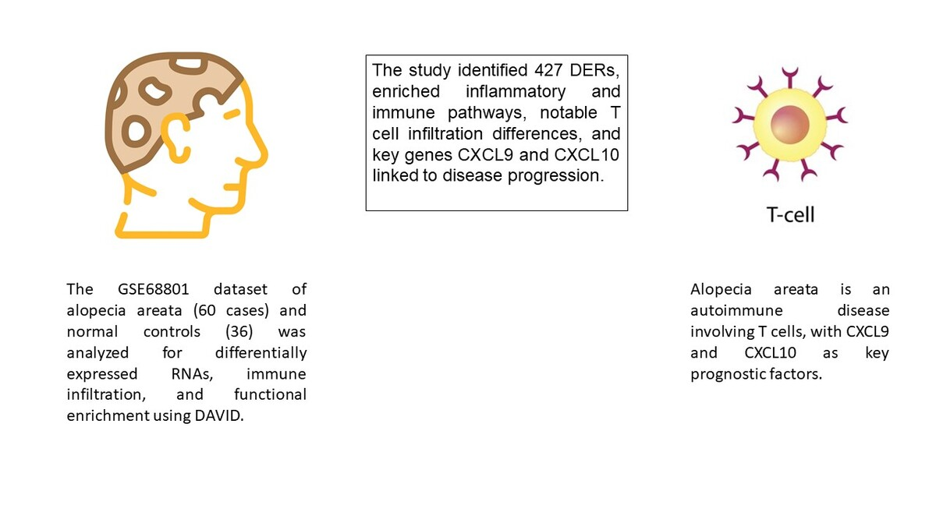

Comparative investigation of immune-related biomarkers related to alopecia areata subtypes
DOI: 10.5114/aoms/192425
Arch Med Sci 2025;21(5):2113-2124
Notes:
Introduction
The study aimed to explore the underlying immunologic mechanisms and immune-related biomarkers associated with alopecia areata (AA) development.
Material and methods
Expression data from the GSE68801 dataset, concerning 60 individuals with alopecia areata (28 patchy-type AA (AAP), 23 alopecia universalis (AU), 9 alopecia totalis (AT)), and 36 normal controls (NC), were analyzed. The study investigated differentially expressed RNAs (DERs), immune infiltration, and immune-related modules. Functional enrichment analysis of overlapping DERs was conducted using DAVID. Additionally, overlapping pathways and genes identified in a co-expression network, along with data from the Comparative Toxicogenomics Database 2019 update, were screened.
Results
In total, 1708 lncRNAs and 17,326 mRNAs, along with 427 overlapping DERs among AAP, AU, AT, and NC, were identified. Subsequently, 17 biological processes significantly associated with inflammatory and immune responses, as well as 8 KEGG signaling pathways, including the chemokine and cytokine-cytokine receptor interaction pathway, were enriched. Notable differences in the infiltration of four T cell subtypes – activated CD8 T cells, effector memory CD8 T cells, regulatory T cells, and plasmacytoid dendritic cells – were observed compared to NC. Two modules were found to be significantly linked to disease stage progression and various T cell types. Functional analysis revealed significant enrichment of cytokine-cytokine receptor interaction and the T cell receptor signaling pathway among the genes involved in these modules. Furthermore, CXCL9 and CXCL10 were identified as key nodes associated with the disease.
Conclusions
Our study revealed that AA is an autoimmune disease associated with T cells, with CXCL9 and CXCL10 emerging as significant prognostic factors in its development.

