Slide 1
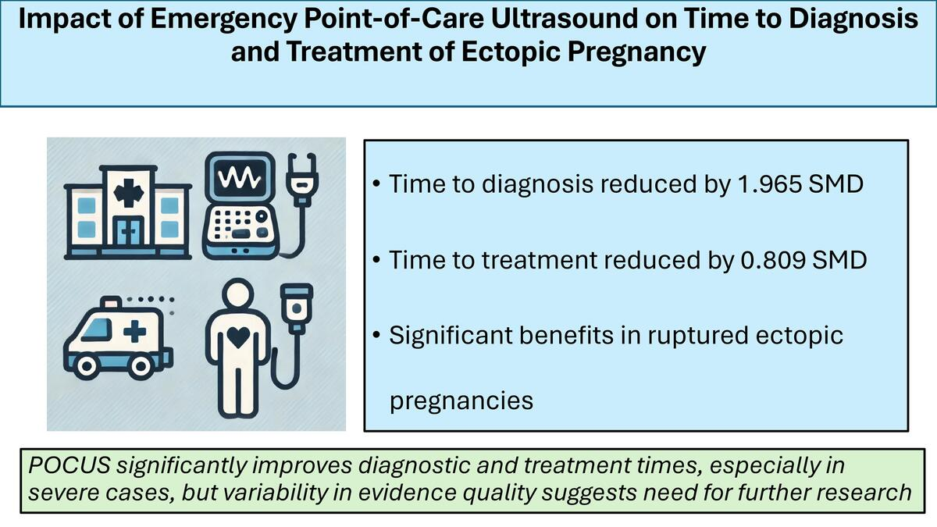

Impact of emergency point-of-care ultrasound on time to diagnosis and treatment amongst patients with ectopic pregnancy: a systematic review and meta-analysis
DOI: 10.5114/aoms/192513
Arch Med Sci 2025;21(5):1997-2006
Notes:
Introduction
Ectopic pregnancy, a significant cause of morbidity in women of reproductive age, requires timely diagnosis and treatment to reduce adverse outcomes. This study examines the impact of point-of-care ultrasound in the emergency department on the time to diagnosis, treatment, and surgical intervention for ectopic pregnancies.
Material and methods
Our review encompassed studies involving patients with ectopic pregnancies who underwent point-of-care ultrasound in emergency settings. The comparator was standard radiology department ultrasound. We included studies of any design, and the key outcomes were time to diagnosis, treatment, and operating room. Data synthesis employed a random-effects inverse-variance model. The GRADE approach was used to assess evidence quality, and the PRISMA checklist guided our methodology.
Results
Overall, four studies were included. For time to diagnosis, the pooled standardized mean difference (SMD) was –1.965, indicating a significant reduction. For time to treatment, the pooled SMD was –0.809, showing a modest effect with considerable heterogeneity (I² = 87.5%). In surgically treating ectopic pregnancies, the impact was not statistically significant overall, but was significant for the subgroup of ruptured ectopic pregnancies. The overall quality of evidence was deemed very low due to moderate risk of bias, high heterogeneity, and publication bias.
Conclusions
Point-of-care ultrasound in emergency departments significantly reduced the time to diagnose ectopic pregnancies. The effect on time to treatment and operating room varied, with notable benefits observed in more severe cases. Despite these promising findings, the quality of evidence and high heterogeneity necessitate cautious interpretation and call for further research.

