Slide 1
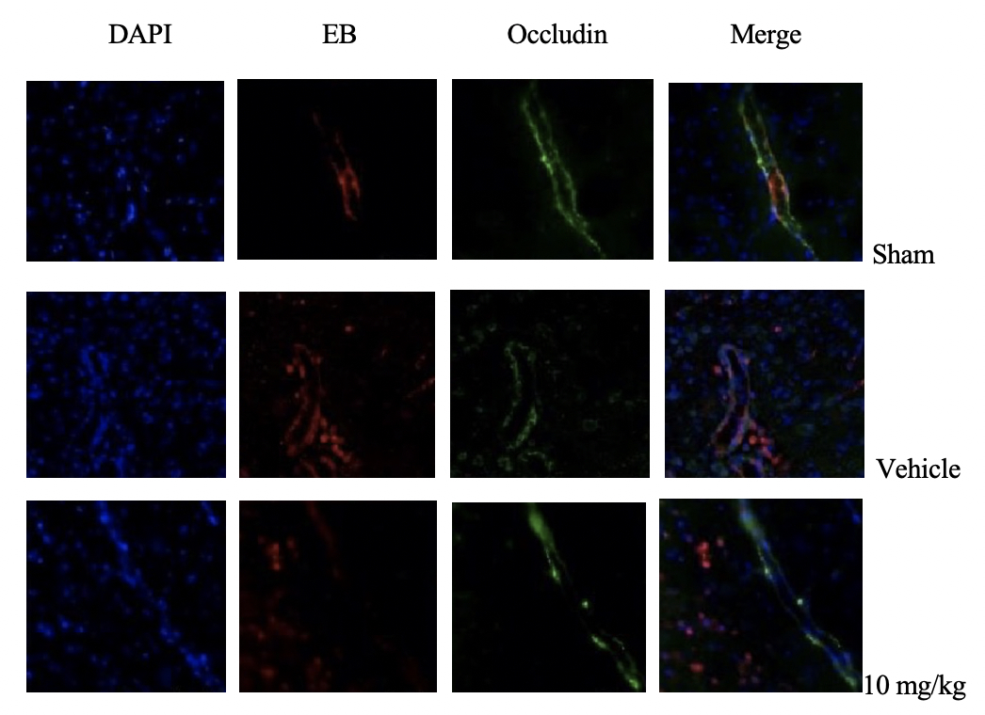

Sanguiin inhibits cerebral hemorrhage in rats by protecting the blood-brain barrier
DOI: 10.5114/aoms/193019
Arch Med Sci 2024;20(4):1345-1348
Notes:
Introduction
The aim of the study was to observe the effect of Sanguiin on cerebral edema and behavior in a rat cerebral hemorrhage model.
Material and methods
A rat collagenase-induced cerebral hemorrhage model was established to detect the effects of drugs on brain edema.
Results
Through magnetic resonance imaging (MRI) analysis and brain weight content (BWC) determination, it was found that Sanguiin could significantly reduce the brain swelling index and BWC of the affected hemisphere after cerebral hemorrhage.
Conclusions
Sanguiin can significantly improve the neurological deficits in rats with cerebral hemorrhage, and down-regulate the expression of MMP-9 after cerebral hemorrhage, suggesting that Sanguiin has a certain protective effect on the blood-brain barrier after cerebral hemorrhage.

