Slide 1
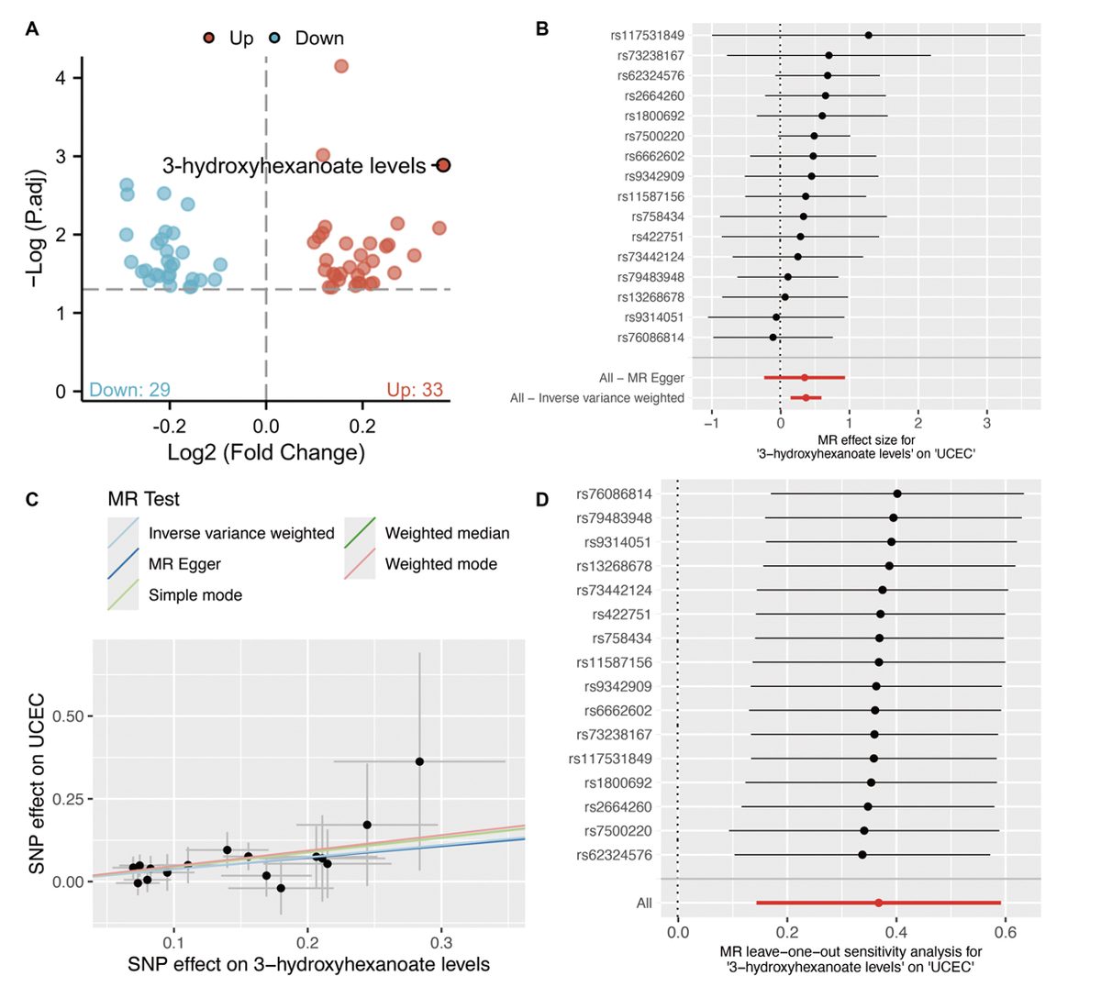

CSF1 mediating 3-hydroxyhexanoate in endometrial cancer: a Mendelian randomization study
DOI: 10.5114/aoms/193392
Arch Med Sci 2024;20(5):1731-1735
Notes:
Introduction
Results
Conclusions

