Slide 1
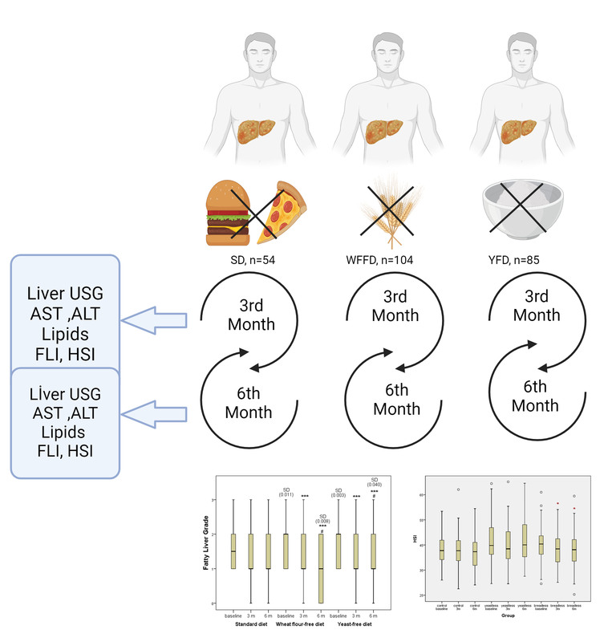

Assessing the impact of a wheat flour and baker’s yeast restricted diet vs. calorie restriction in non-alcoholic fatty liver disease patients
DOI: 10.5114/aoms/193393
Arch Med Sci 2025;21(3):719-728
Notes:
Introduction
Non-alcoholic fatty liver disease (NAFLD) is a prevalent and nonalcoholic, progressive liver disorder associated with metabolic disturbance. This study aimed to compare the efficacy of a wheat flour or baker’s yeast restricted diet with traditional calorie restriction in NAFLD patients.
Material and methods
The analysed data were obtained from 243 individuals with NAFLD, who completed the study. Of these patients, 54 belonged to Group (1) (standard diet, SD), 104 belonged to Group (2) (wheat flour-free diet, WFFD), and 85 belonged to Group (3) (yeast-free diet, YFD). The intervention period lasted 6 months, during which participants’ dietary compliance was closely monitored. Anthropometric measurements, liver function tests, and imaging studies were conducted at baseline, after 3 months, and at the endpoint.
Results
At the end of the 6-month trial, both the WFFD and HFD groups exhibited a noteworthy reduction in body mass index (BMI) and triglyceride (TG) levels when compared to a standard diet that only involved calorie restriction. Furthermore, a notable reduction in the severity of liver steatosis was seen in these groups (p < 0.05). The SD group did not exhibit any significant changes in these metrics. The WFFD group experienced a notable reduction in Hepatic Steatosis Index (HSI) values (p < 0.05). Cluster analysis revealed that the obese group had higher HSI, weight, and BMI values throughout the study period, indicating a more advanced stage of NAFLD.
Conclusions
This study highlights the significance of food constituents and dietary strategies in the treatment of NAFLD. It suggests that limiting the intake of wheat flour and baker’s yeast specifically could have positive effects on liver well-being. Nevertheless, it is imperative to conduct comprehensive and enduring investigations that consider the genetic and metabolic variations among individuals. The results of this study provide evidence that customised dietary approaches designed to meet people’s specific nutritional requirements could be crucial in the treatment of NAFLD.

