Slide 1
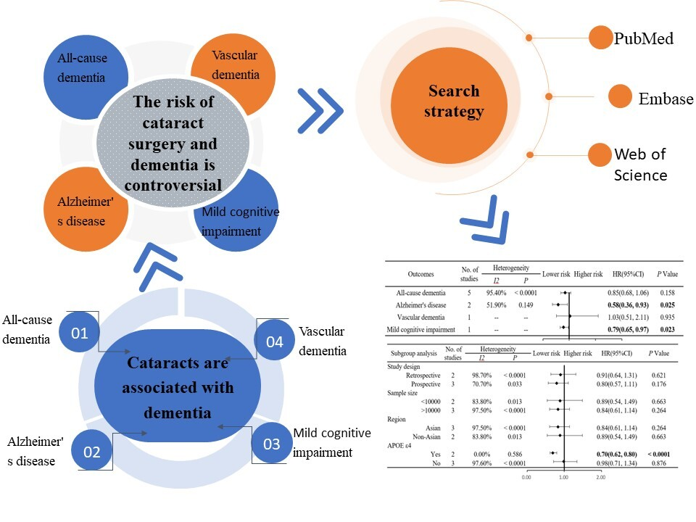

Association of cataract surgery with risk of dementia: a meta-analysis and systematic review of cohort studies with 720,075 participants
DOI: 10.5114/aoms/193394
Arch Med Sci 2024;20(5):1720-1726
Notes:
Introduction
Material and methods
Results
Conclusions

