Slide 1
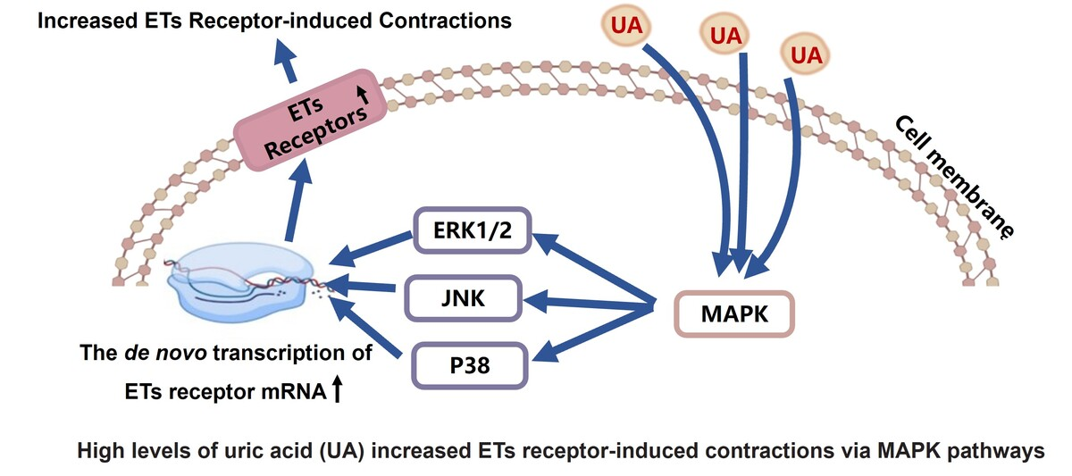

High levels of uric acid upregulate endothelin receptors: the role of MAPK pathways in an in vitro study
DOI: 10.5114/aoms/193455
Arch Med Sci 2025;21(4):1602-1611
Notes:
Introduction
Uric acid (UA) is the end product of the metabolism of purine compounds. There is overwhelming evidence linking hyperuricaemia (high levels of UA) and cerebrovascular diseases, but the effect of high levels of UA on cerebral vessels is not fully understood. The aim of this research is to clarify how UA affects the endothelin (ET) receptor in rat cerebral arteries and the related mechanism.
Material and methods
In an in vitro setting, segments of rat cerebral arteries (n = 12) were exposed to high levels of UA, either alone or in conjunction with MAPK pathway inhibitors. ET agonists were used to induce contractions that were then measured with a myograph. ET receptor expression was measured using RT-PCR (n = 6), western blot (n = 3), or immunohistochemistry (n = 3) to quantify mRNA and protein levels.
Results
The study revealed that high levels of UA notably increase ETA and ETB receptor-induced contractions and boosted the expression of ET receptors in cerebral arteries when compared to fresh or cultured alone, suggesting that UA enhances ETA and ETB receptors. Additionally, the up-regulation of ETB receptors induced by UA was inhibited by the p38 inhibitor SB203580, the JNK inhibitor SP600125, and the ERK1/2 inhibitor U0126. SB203580 significantly blocked the increase in ETA receptor-mediated contractions induced by UA and the upregulation of ETA receptor. Neither SP600125 nor U0126 had such an effect.
Conclusions
High levels of UA stimulate the up-regulation of ET receptors in rat cerebral arteries in vitro through MAPK pathways. This study may offer novel perspectives on hyperuricaemia-associated cerebrovascular diseases.

