Slide 1
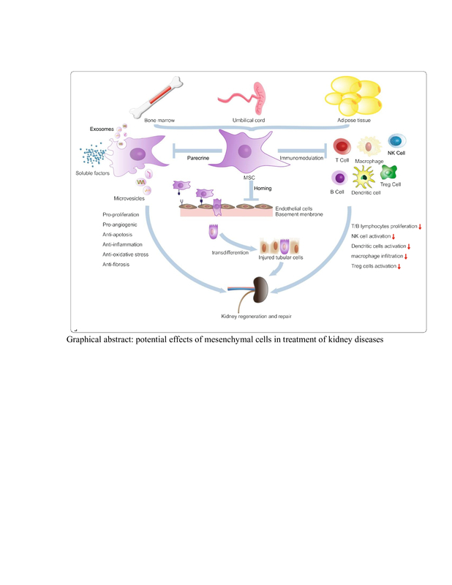

Therapeutic potential of mesenchymal stem cells in cisplatin-induced acute kidney injury via ASK-1/TXNIP pathway modulation
DOI: 10.5114/aoms/193707
Arch Med Sci 2025;21(6):2826-2837
Notes:
Introduction
Acute kidney injury (AKI) is a diverse set of illnesses characterized by a rapid decline in kidney function. However, kidney transplantation and supportive therapies still have many limitations in slowing the progression of kidney diseases. The effective role of mesenchymal stem cells (MSCs) in cell-based therapy and endogenous repair for AKI is still under investigation. Several studies have indicated that MSCs could both repair and ameliorate kidney injury due to its anti-inflammatory and anti-apoptotic potential effects. The aim of this study was to evaluate the effects of MSCs on renal cell apoptosis in cisplatin-induced AKI rats and examine the underlying molecular mechanisms.
Material and methods
Characteristics and homing of MSCs to kidney tissues were identified by flow cytometry and differentiation capability. After AKI induction by cisplatin injection in sixteen albino rats, the AKI rats were further subdivided into three subgroups. The first subgroup served as a positive control and the second one received 2 mg/kg furosemide (FUR), which served as a standard drug. The third subgroup received a single dose of 5 × 106 MSCs via tail vein injection once a week for 2 consecutive weeks. AKI-related biochemical parameters were assayed at 2 weeks after MSC treatment. Kidney histological changes were also evaluated. Moreover, apoptosis of kidney cells and expression of apoptosis-related proteins were assessed by western blot.
Results
Compared with AKI rats, rats treated with MSCs showed suppressed serum levels of creatinine and blood urea nitrogen. MSC treatment alleviated the pathological abnormalities in the kidneys of AKI rats as shown by H&E staining. Furthermore, MSC treatment suppressed apoptosis of kidney cells in AKI rats via downregulation of apoptotic proteins: thioredoxin-interacting protein (TXNIP) and apoptosis signal-regulating kinase 1 (ASK1). Most importantly, MSC treatment promoted the expression of vascular endothelial growth factor (VEGF) in the kidneys of AKI rats.
Conclusions
Our results suggest that MSCs could ameliorate renal injury of AKI rats via their anti-apoptotic properties. Also, the protective effects of MSCs may be mediated by their potential angiogenic effects.

