Slide 1
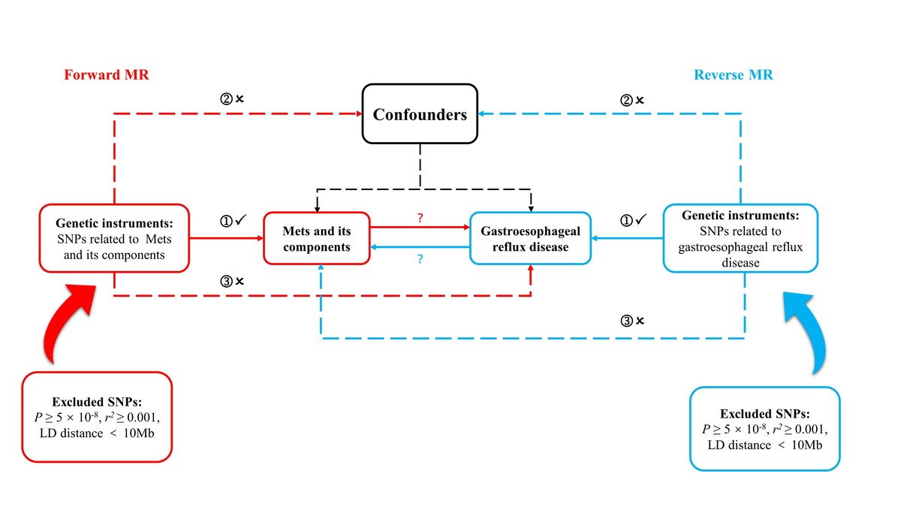

Association between gastroesophageal reflux disease and metabolic syndrome: a bidirectional two-sample Mendelian randomization analysis
DOI: 10.5114/aoms/193708
Arch Med Sci 2024;20(5):1715-1719
Notes:
Introduction
Methods
Results
Conclusions

