Slide 1
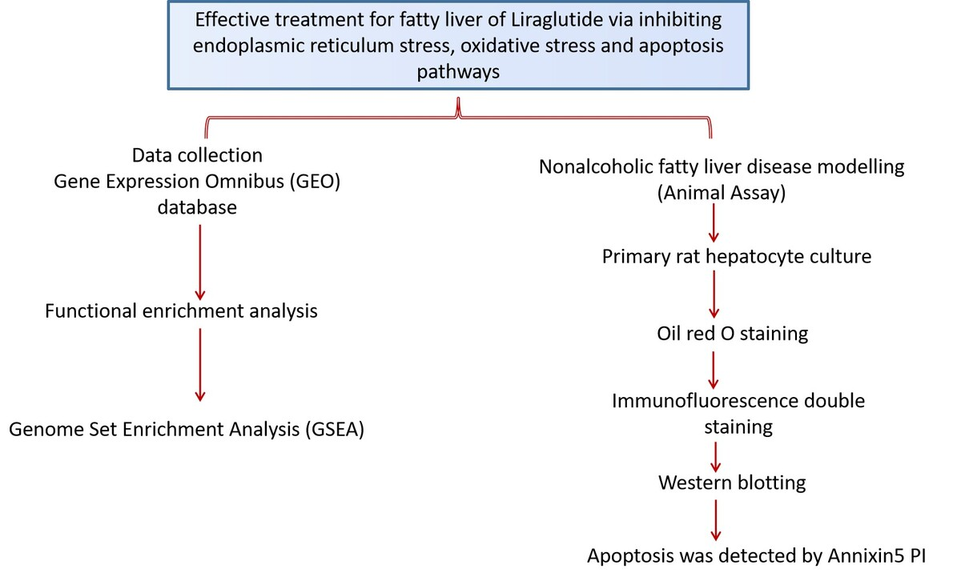

Effective treatment for fatty liver of liraglutide via inhibiting endoplasmic reticulum stress, oxidative stress and apoptosis pathways
DOI: 10.5114/aoms/186658
Arch Med Sci 2025;21(4):1432-1448
Notes:
Introduction
Fatty liver disease (FLD) is a frequent medical condition marked by hepatic adipose tissue accumulation. It may cause liver damage in certain cases. This study examined liraglutide’s inhibition of FLD and its molecular mechanism.
Material and methods
GSE63067 was downloaded from the Gene Expression Omnibus (GEO) database. The analysis of differentially expressed genes (DEGs) was performed using the Limma package. Enrichment analysis was performed. The Sprague-Dawley (SD) rats were fed a high-fat diet to develop FLD, then administered liraglutide. Serum lipid levels were tested by ELISA, and pathological sections were used for oil red O staining. In in vitro experiments, the hepatic cells were stimulated with free fatty acids (FFAs), liraglutide, and tunicamycin. Immunofluorescence double staining and western blot testing were carried out.
Results
Enrichment analysis showed that DEGs were enriched in endoplasmic reticulum (ER) stress, oxidative stress, and apoptosis pathways. Liraglutide treatment reduced the expression of p-PERK and CHOP resulting from FFAs. Western blot assessment revealed that liraglutide treatment reduced the expression of GRP78, GRP94, p-PERK, p-IRE1, ATF6, and CHOP resulting from FFAs but not the expression of these proteins resulting from FFAs and tunicamycin. Flow cytometry revealed that liraglutide treatment reduced SD rat liver cell apoptosis resulting from FFAs. Liraglutide treatment decreased the expression of cleaved caspase-3, caspase-9, caspase-12, and Bax resulting from FFAs.
Conclusions
Liraglutide exerts a therapeutic effect in the context of FLD through its ability to suppress endoplasmic reticulum stress (ERS) and inhibit apoptosis of hepatic cells.

