Slide 1
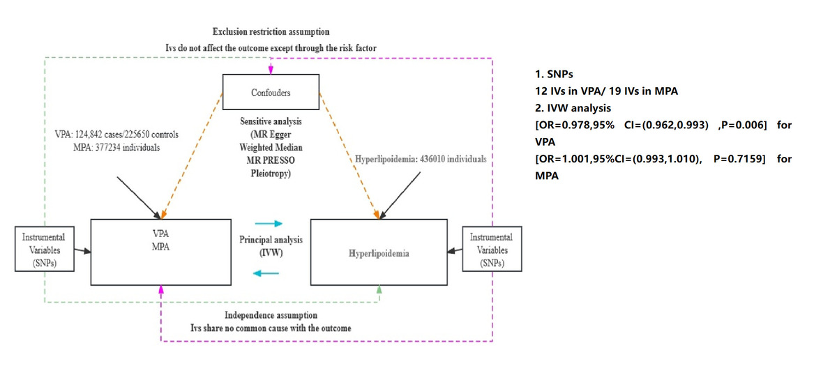

Analysis of the causal relationship between hyperlipidaemia and exercise intensity: based on two-sample Mendelian randomisation
DOI: 10.5114/aoms/194192
Arch Med Sci 2024;20(5):1701-1704
Notes:
Introduction
Material and methods
Results
Conclusions

