Slide 1
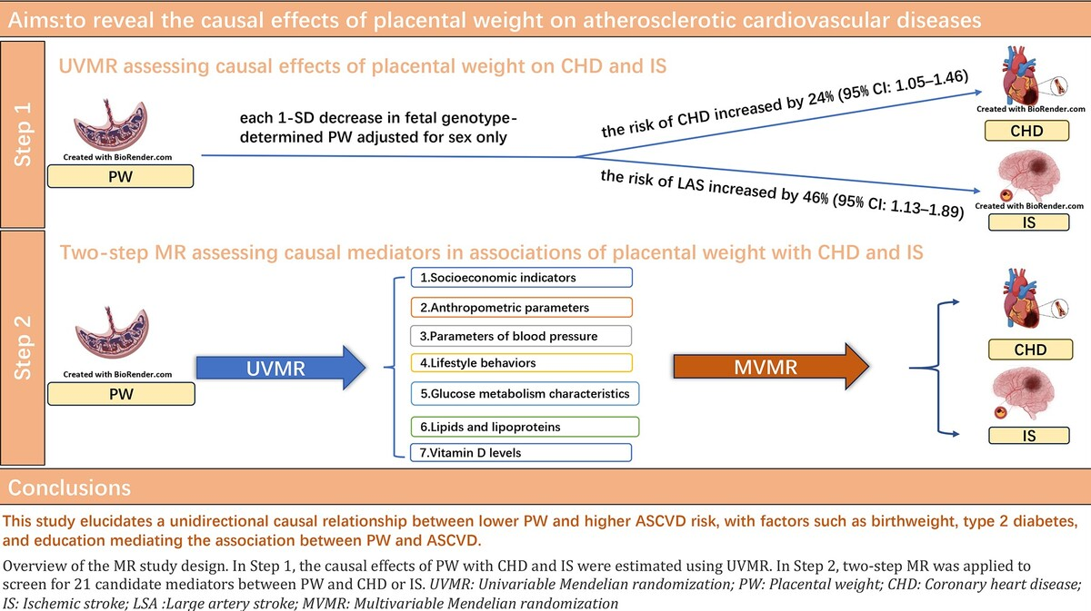

The causal effects of placental weight on atherosclerotic cardiovascular disease: a Mendelian randomization and mediation analysis
DOI: 10.5114/aoms/194244
Arch Med Sci 2025;21(4):1141-1151
Notes:
Introduction
Previous studies have linked placental weight (PW) to cardiovascular diseases, but the causality and potential mediators underlying this relationship are still unknown.
Material and methods
We conducted Mendelian randomization (MR) analysis via summary statistics from genome-wide association studies (GWAS), including PW adjusted for sex, 21 candidate mediators and atherosclerotic cardiovascular disease (ASCVD), which includes coronary heart disease (CHD) and ischemic stroke (IS). Two-step MR was employed to identify and assess the mediation and proportion of potential mediators in the association between PW and ASCVD. Additionally, we conducted a repeated analysis using PW adjusted for gestational age and sex.
Results
Univariable MR (UVMR) analysis revealed that for each 1-SD decrease in fetal genotype-determined PW adjusted for sex only, the risk of CHD increased by 24% (95% CI: 1.05–1.46) and the risk of large artery stroke (LAS) increased by 46% (95% CI: 1.13–1.89). Similar results were obtained in repeated analyses. The mediation MR analysis revealed that the causal relationship between fetal genotype-determined PW and CHD risk was primarily mediated by birthweight, type 2 diabetes, and education, each mediating 3.66% to 40.80% of the total effect. The causal relationship between fetal genotype-determined PW and LAS risk was mediated mainly by type 2 diabetes, which accounted for 22.11% of the total effect.
Conclusions
This study identified a unidirectional causal relationship between lower PW and a greater ASCVD risk, with factors such as birthweight, type 2 diabetes, and education mediating the association between PW and ASCVD.

