Slide 1
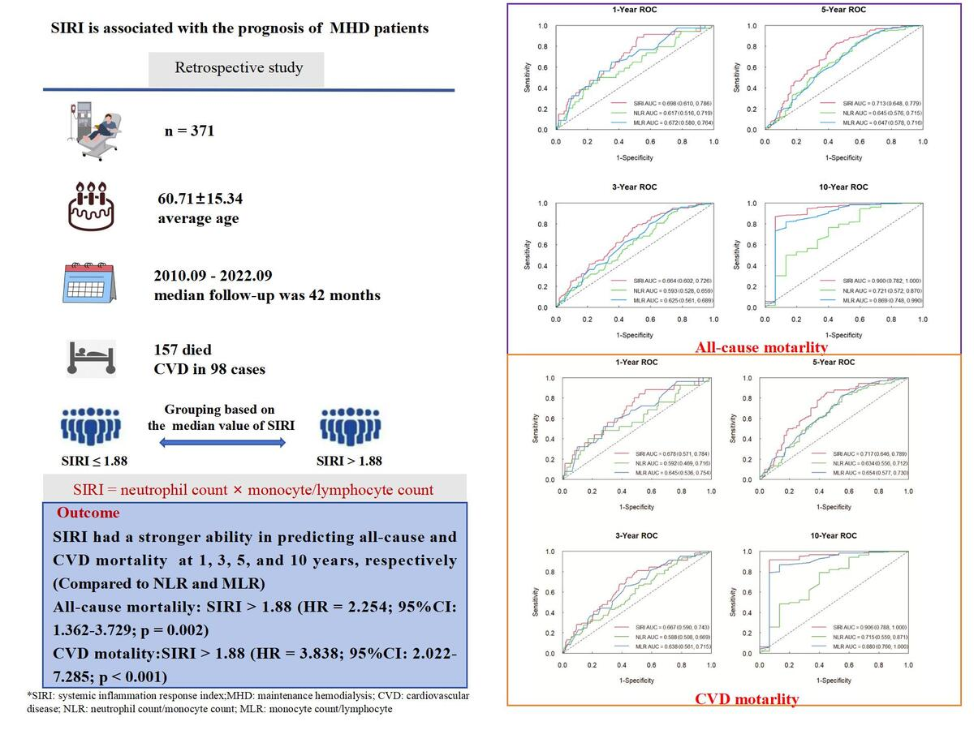

The systemic inflammation response index (SIRI) is associated with all-cause and cardiovascular mortality in maintenance hemodialysis patients
DOI: 10.5114/aoms/194534
Arch Med Sci 2025;21(4):1252-1262
Notes:
Introduction
The aim of this study was to investigate the association between the systemic inflammation response index (SIRI) and all-cause and cardiovascular disease (CVD) mortality in maintenance hemodialysis (MHD) patients.
Material and methods
371 MHD patients were included in this retrospective study. Time-dependent receiver operating characteristic (ROC) curve analysis was used to evaluate the predictive value of SIRI. Patients were categorized into two groups based on the median SIRI value. Kaplan-Meier survival analysis was used to compare the difference in survival rate. Cox regression analysis was used to analyze all-cause and CVD mortality risk factors, and nomograms were developed.
Results
The average age of the patients was 60.71 ±15.34 years, and the median follow-up was 42 months. 157 patients died. SIRI had predictive value for all-cause and CVD mortality. The AUC of the SIRI to predict all-cause mortality was 0.698, 0.664, 0.713, and 0.900 at 1, 3, 5, and 10 years, respectively. For CVD mortality, the AUC of the SIRI was 0.678, 0.667, 0.717, and 0.906 at 1, 3, 5, and 10 years, respectively. Kaplan-Meier survival analysis showed that patients with high SIRI values had a significantly lower survival rate. Multivariate Cox regression analysis showed that SIRI > 1.88 was an independent risk factor for all-cause and CVD mortality.
Conclusions
SIRI can independently predict all-cause and CVD mortality in MHD patients, which has important value for prognosis.

