Slide 1
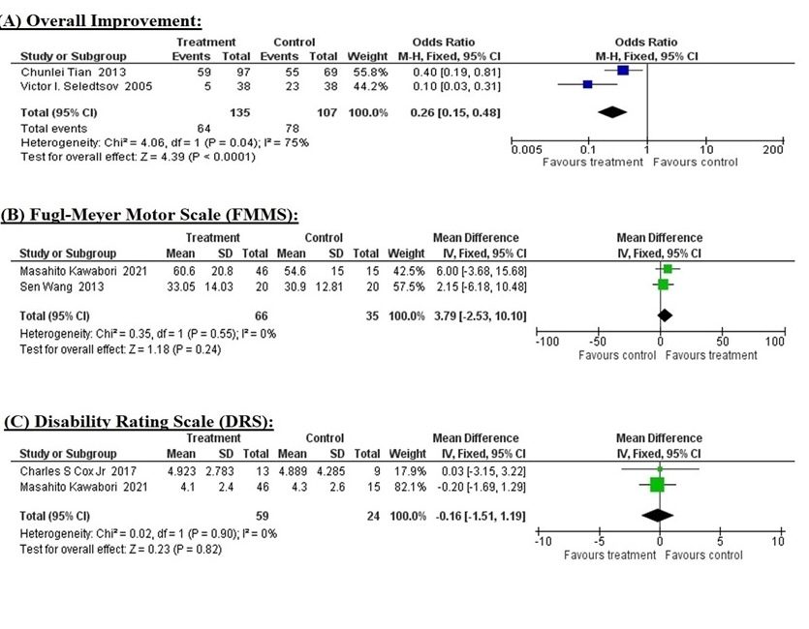

Cellular therapy for traumatic brain injury in adults: a meta-analysis of controlled clinical trials
DOI: 10.5114/aoms/194535
Arch Med Sci 2025;21(6):2467-2475
Notes:
Introduction
Traumatic brain injury (TBI) lacks effective clinical treatment. Cellular therapy, which is the transfer of autologous or allogeneic cells or cellular material into the patient(s) for treatment or prevention of disease, has shown better outcomes in TBI in several clinical and preclinical studies. We performed a meta-analysis to synthesize and evaluate the current evidence on cellular therapy for TBI in adult patients.
Material and Methods
We performed a meta-analysis on published articles on the topic of cellular therapy for the treatment of TBI in adult patients. The literature search was conducted via PubMed, China National Knowledge Infrastructure (CNKI), Cochrane Library, Embase, Wan Fang Data and Google Scholar, with no restrictions on publication year. Studies were included based on selection criteria and quality assessment. The following data were extracted from included articles: author names; publication year and place; type of study; number, sex and age of participants; type of cells used; and post-treatment follow-up. The required data related to the Fugl-Meyer Motor Scale (FMMS), the Disability Rating Scale (DRS), and patients’ overall improvement were pooled and analyzed using RevMan (Ver. 5.4.1).
Results
Five studies that met the selection criteria and considered as high quality, containing 367 participants, with an average follow-up time of 7.58 ±6.93 months, were included in the meta-analysis. The results showed that cellular therapy significantly improved (OR = 0.26; 95% CI = 0.15 to 0.48; p = 0.0001) the overall performance of the patients. While improvements in the FMMS (MD = 3.79; 95% CI = –2.53 to 10.10; p = 0.24) and DRS (MD = –0.16; 95% CI = –1.51 to 1.19; p = 0.82) were not statistically significant, they may still be clinically significant.
Conclusions
This meta-analysis suggests that cellular therapy improves the clinical condition of TBI patients. Larger, multicenter clinical trials are required to further confirm these findings and clarify the optimal use of stem cells in TBI.

