Slide 1
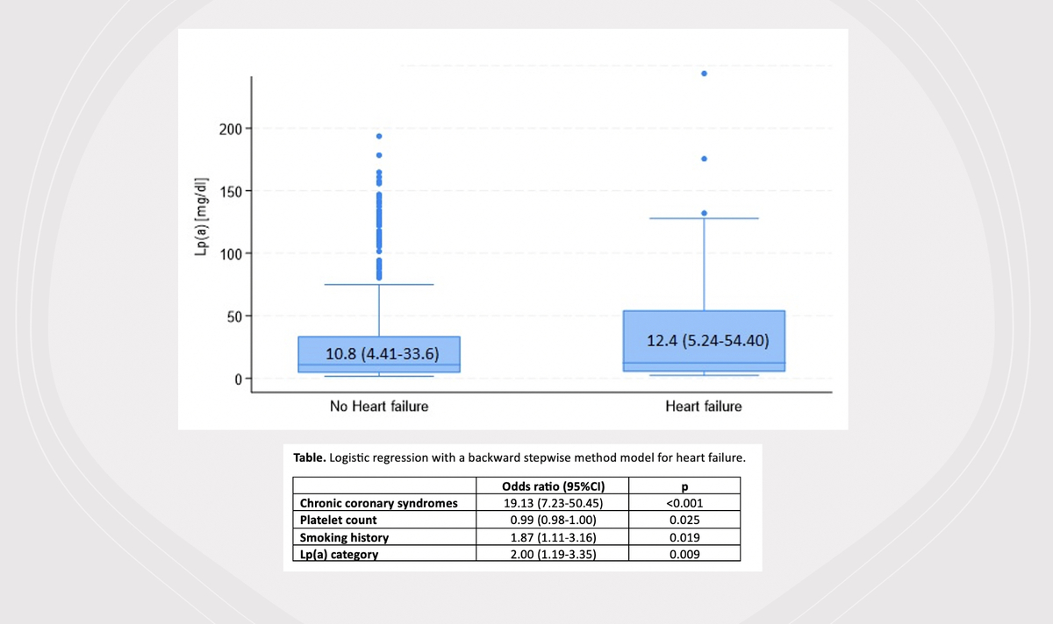

Lipoprotein(a) and other risk factors in dyslipidemic patients with and without heart failure
DOI: 10.5114/aoms/194684
Arch Med Sci 2024;20(5):1705-1709
Notes:
Introduction
Material and methods
Results
Conclusions

