Slide 1
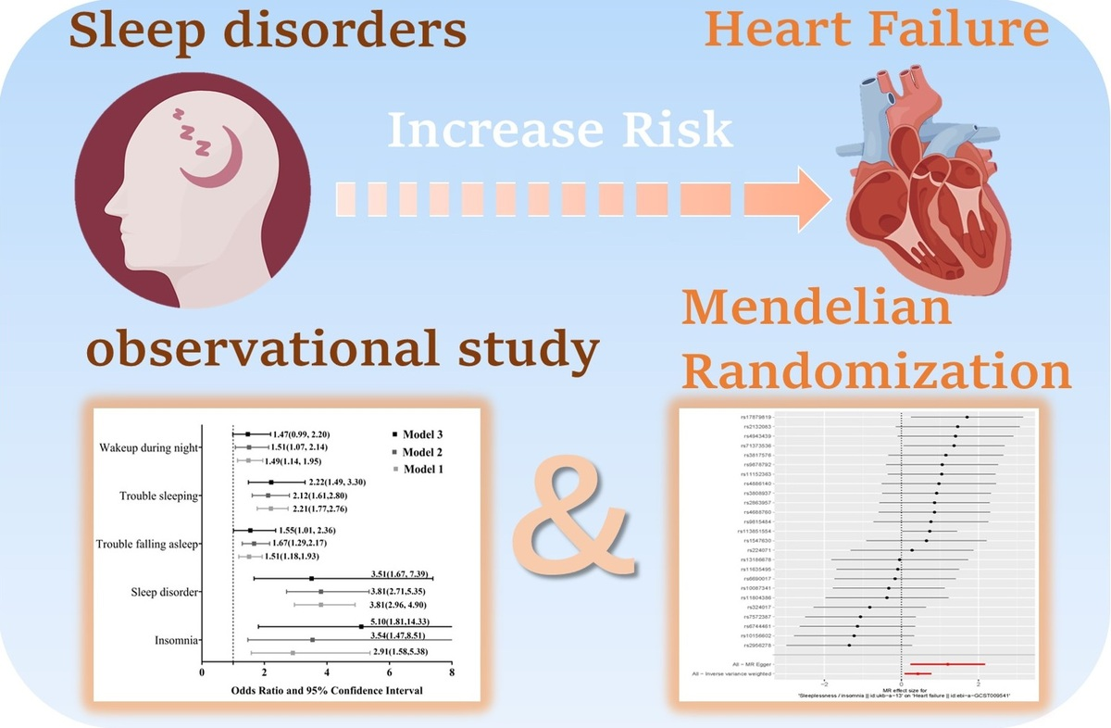

Sleep disturbances and heart failure: observational study and Mendelian randomization study
DOI: 10.5114/aoms/194883
Arch Med Sci 2025;21(4):1222-1232
Notes:
Introduction
Sleep disturbances are prevalent among patients with heart failure (HF) and may trigger acute exacerbations of the condition. However, the causal relationship between sleep disturbances and HF remains uncertain. This study aimed to explore the association and potential causal relationship between sleep disturbances and HF.
Material and methods
Observational study: NHANES data (2005–2008) involving 10,432 participants. Sleep disturbances defined as insomnia, sleep disorders, difficulty falling asleep, trouble sleeping, and nocturnal awakening. Mendelian randomization (MR) study: Genetic variants linked to sleeplessness were obtained from GWAS datasets. MR two-sample analysis was conducted using summary statistics from sleeplessness and HF GWASs.
Results
After full adjustment, the association between insomnia and HF remained significant, with an OR of 5.10 (1.81–14.33, <i>p</i> = 0.003). After full adjustment, the association between sleep disorder and HF remained significant, with an OR of 3.51 (1.67–7.39; <i>p</i> = 0.002). The IVW method provided evidence supporting a causal association between sleeplessness and HF (OR = 1.535, SE = 0.177, <i>p</i> = 0.016). MR-Egger analysis demonstrated a causal association between sleeplessness and HF (OR = 3.333, SE = 0.493, <i>p</i> = 0.023). Our observational study may be influenced by unaddressed confounding factors; however, Mendelian randomization helps mitigate the bias and confounding commonly found in non-genetic observational research.
Conclusions
Our study identified a correlation between sleep disturbances and HF, potentially suggesting a causal relationship. Addressing sleep disturbances may be a key strategy in reducing the risk of HF.

