Slide 1
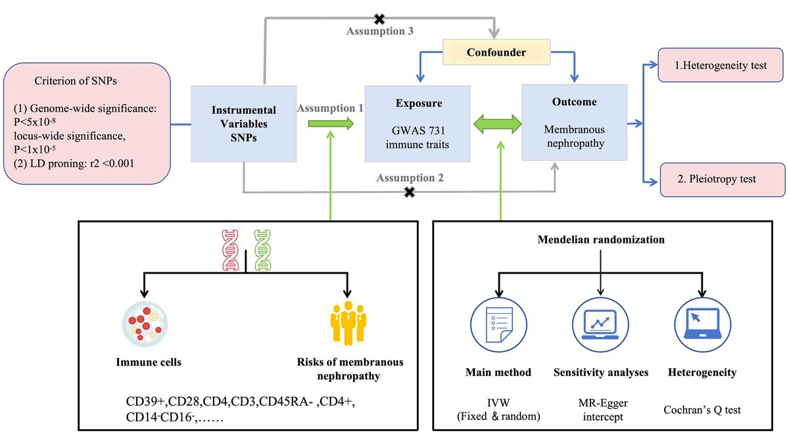

Association between immune cells and membranous nephropathy: a two-sample Mendelian randomization study
DOI: 10.5114/aoms/194884
Arch Med Sci 2025;21(4):1263-1270
Notes:
Introduction
Multiple studies have indicated that immune cells play a significant role in the occurrence and development of membranous nephropathy (MN). However, the causal relationship between the two has not been fully established. To further investigate this, we employed a Mendelian randomization (MR) study design.
Material and methods
Genetic instrumental variables for immune cells were sourced from an extensive genome-wide association study (GWAS). MN summary statistics, involving 2,150 cases and 5,829 controls, were obtained from a separate GWAS. The primary analysis employed the inverse-variance weighted (IVW) method. To explore reverse causation, a reverse MR analysis was undertaken. Rigorous sensitivity analyses were conducted to ensure the resilience and reliability of the study’s findings.
Results
We identified eight immunophenotypes associated with a reduced risk of MN, and all of them were protective factors for MN. The sensitivity analyses consistently yielded similar results for these immune traits. In the reverse MR analysis, we did not observe any statistically significant associations between MN and these eight immunophenotypes.
Conclusions
Our study, utilizing genetic approaches, provides evidence for a causal relationship between immune cells and MN, which has implications for clinical diagnosis and treatment. Further comprehensive investigations are needed to explore the detailed mechanisms underlying the impact of immune cells on MN.

