Slide 1
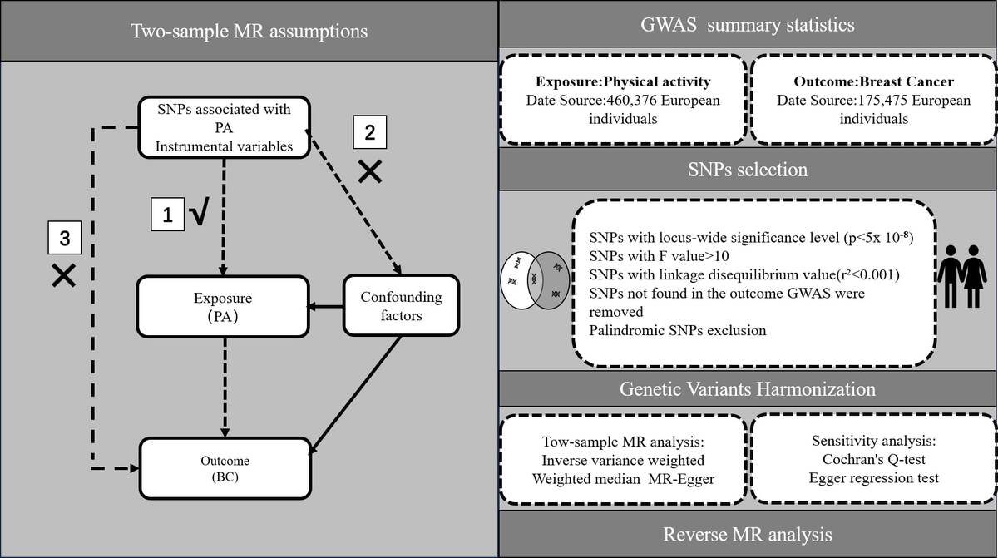

Physical activities and breast cancer: a Mendelian randomization study
DOI: 10.5114/aoms/195271
Arch Med Sci 2024;20(6):1957-1967
Notes:
Introduction
Previous research suggests a potential association between physical activity (PA) and breast cancer (BC), but the causal relationship remains uncertain. The aim of this study was to explore the causal relationship between PA and BC through Mendelian randomization (MR) analysis.
Material and methods
Genome-wide association studies utilizing data from the UK Biobank baseline were employed to analyze PA phenotypes, encompassing 460,376 participants. Summary data for BC, comprising 122,977 cases and 105,974 controls, were obtained from the BC Association Consortium. The cases were further categorized based on estrogen receptor status into estrogen receptor-positive breast cancer (ER+ BC) and estrogen receptor-negative breast cancer (ER– BC). The inverse variance weighted method was employed as the primary approach for two-sample MR. Additionally, the MR-PRESSO (MR-Pleiotropy RESidual Sum and Outlier) method was utilized to eliminate outliers. Tests for heterogeneity and pleiotropy were conducted to enhance result accuracy. Furthermore, multivariable Mendelian randomization was performed, adjusting for potential confounders to ensure result stability.
Results
MR analysis was employed to assess the causal link between PA and BC. Two-sample MR analysis revealed a genetic prediction indicating that walking for pleasure was associated with decreased risk of ER+ BC (odds ratio (OR) = 0.302, 95% CI = 0.105–0.872, p = 0.027), while other physical activities were not significantly correlated with BC, ER+ BC and ER– BC. These findings remained reliable and consistent in the sensitivity analysis, including Cochran’s Q and MR-Egger regression. Furthermore, reverse MR analysis suggested that BC did not exert a notable impact on PA.
Conclusions
Our findings suggest that engaging in leisure walking is associated with a reduced risk of ER+ BC. Nevertheless, additional research is warranted to comprehensively elucidate the underlying mechanisms and strengthen the causal relationship.

