Slide 1
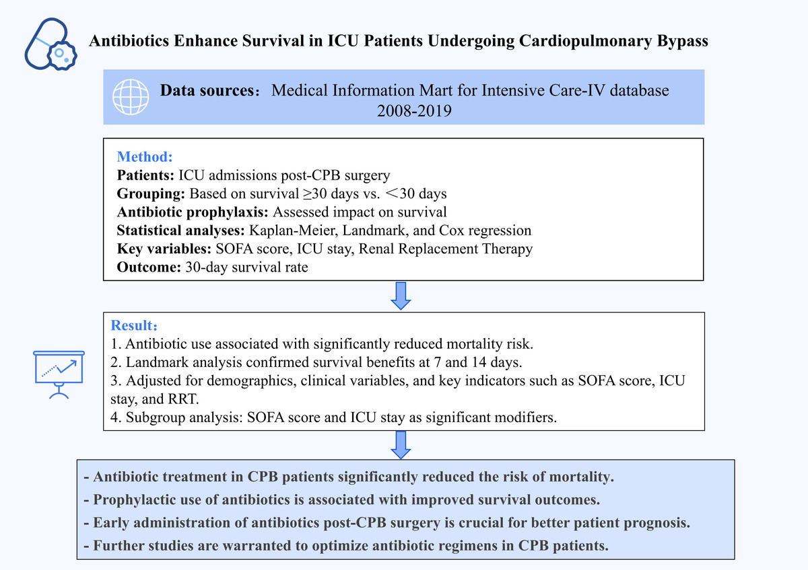

Survival analysis of antibiotics in patients undergoing cardiopulmonary bypass in the intensive care unit: a study based on the Medical Information Mart for Intensive Care-IV database
DOI: 10.5114/aoms/195391
Arch Med Sci 2025;21(5):1874-1886
Notes:
Introduction
This study aimed to evaluate the influence of antibiotics on the survival of patients in the intensive care unit (ICU) undergoing cardiopulmonary bypass (CPB) treatment.
Material and methods
This retrospective cohort study included data of 7,296 patients who underwent CPB surgery and were admitted to the ICU from the MIMIC-IV database. Patients with CPB were grouped according to their survival time of more than 30 days or less after admission and whether antibiotics were used, with baseline characteristics analyzed. Survival differences were assessed using Kaplan-Meier (K-M) curves. Landmark analysis was used to assess inter-group survival differences before and after specific time points. Three models were constructed by adjusting for different covariates. Cox regression analysis assisted with the association analysis between antibiotic use and the mortality risk in CPB patients. According to subgroup analysis, survival differences between distinct subgroups of CPB patients were compared.
Results
In CPB patients grouped according to survival time, large differences were detected in laboratory indexes, comorbidities, and treatment information. In terms of disease severity scores, vital signs, and comorbidity, there were notable differences in the data in CPB patients grouped by whether antibiotics were administered. K-M curves showed that the use of antibiotics substantially increased the 30-day survival rate of all CPB patients as well as CPB patients without sepsis complications. Landmark analysis indicated that the use of antibiotics greatly increased the survival rates of all CPB patients and CPB patients without sepsis complications at 7 and 14 days after ICU admission. Cox regression analysis demonstrated that the mortality risk of patients using antibiotics was significantly reduced in all CPB patients and CPB patients without sepsis complications. The mortality risk was considerably lower in CPB patients with SOFA scores in the range of (–1, 5] (HT = 0.28, 95% CI: 0.21–0.37, p < 0.001), ICU stay ≤ 3 days ((0, 2]: HT = 0.22, 95% CI: 0.15–0.32, p < 0.001; (2, 3]: HT = 0.33, 95% CI: 0.21–0.53, p < 0.001), and those who did not receive renal replacement therapy (RRT) (HT = 0.37, 95% CI: 0.29–0.47, p < 0.001).
Conclusions
In CPB patients admitted to the ICU, the rational use of antibiotics for treatment and prophylaxis can significantly reduce the risk of mortality. These findings provide insights for clinical practice, assisting healthcare professionals to better assess and manage CPB patients in the ICU and formulate appropriate treatment plans to improve patient survival rates.

