Slide 1
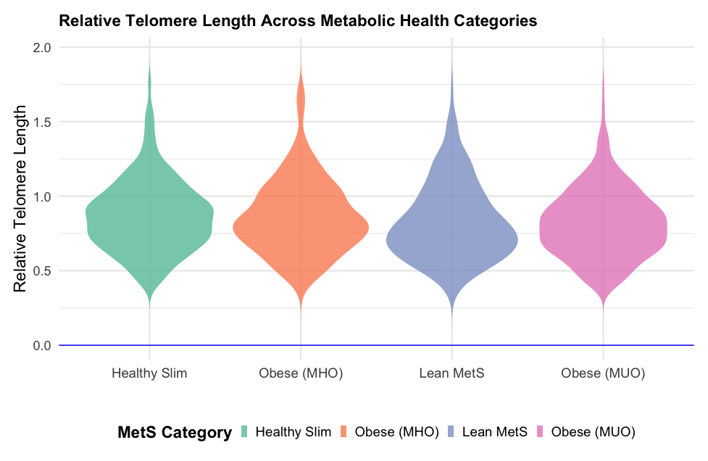

Telomere length across the spectrum of metabolic health: an analysis from the LIPIDOGEN2015 study
DOI: 10.5114/aoms/195465
Arch Med Sci 2025;21(4):1213-1221
Notes:
Introduction
Telomere length is a cellular aging marker and correlates with various cardiovascular disease (CVD) risk factors. The current study assessed the association between obesity, metabolic syndrome (MetS), and telomere length.
Material and methods
The LIPIDOGRAM&LIPIDOGEN2015 study was conducted in primary care in 2015–2016. Patients recruited to the LIPIDOGEN2015 cohort (<i>n</i> = 1788) were a random subset of patients of the LIPIDOGRAM2015 (<i>n</i> = 13,724) study. For the aims of this analysis, the recruited patients were divided into four groups based on the presence of MetS: healthy slim (HS), metabolically healthy obese (MHO), non-obese with MetS (NOMS), and metabolically unhealthy obese (MUO). Relative telomere length (RTL) was measured using quantitative polymerase chain reaction (qPCR).
Results
1516 patients (85% of the total group; 59.7% female, mean age 50.3 years) were included in the final analyses. Increases in body mass index (BMI), waist circumference, prevalence of diabetes mellitus, hypertension, dyslipidemia, and history of myocardial infarction moving from HS to MUO were observed. The MUO group exhibited the highest triglyceride and lowest high-density lipoprotein (HDL-C) levels. In the univariate regression analyses, NOMS (<i>p</i> = 0.038) and MUO (<i>p</i> = 0.003) were associated with significantly decreased RTL. After adjusting for age, gender, education, smoking, place of residence, and myocardial infarction, the association was no longer statistically significant.
Conclusions
Despite the lack of statistical significance in the multivariate analysis, the univariate results suggest that both MUO and NOMS phenotypes contribute to the shortening of telomere length. These results may also indicate that MetS, irrespectively of obesity occurrence, is responsible for the shortened lifespan.

