Slide 1
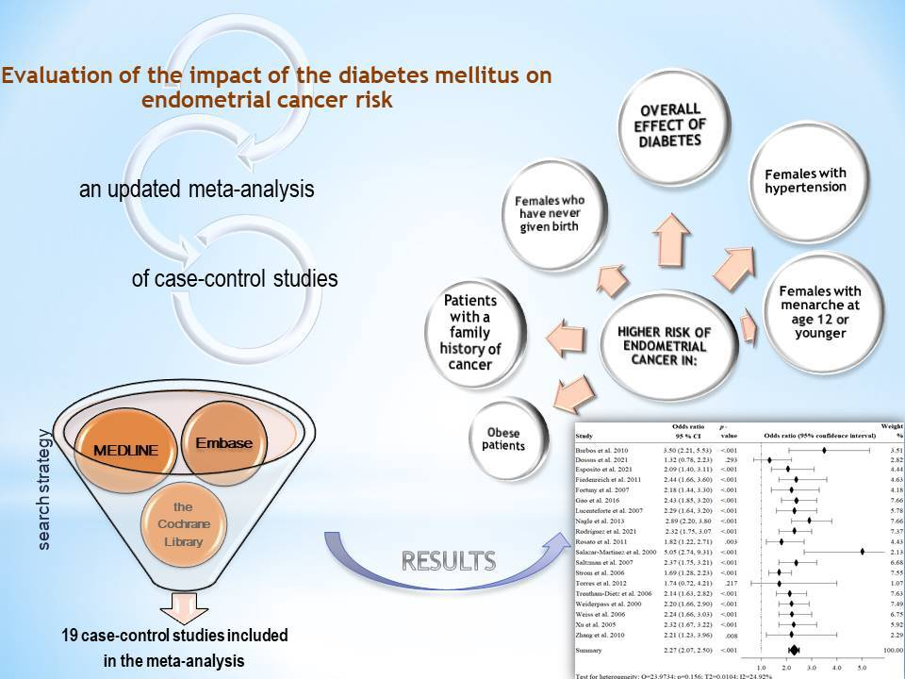

Evaluation of the impact of diabetes mellitus on endometrial cancer risk: an updated meta-analysis of case-control studies
DOI: 10.5114/aoms/196001
Arch Med Sci 2024;20(6):2056-2062
Notes:
Introduction
Material and methods
Results
Conclusions

