Slide 1
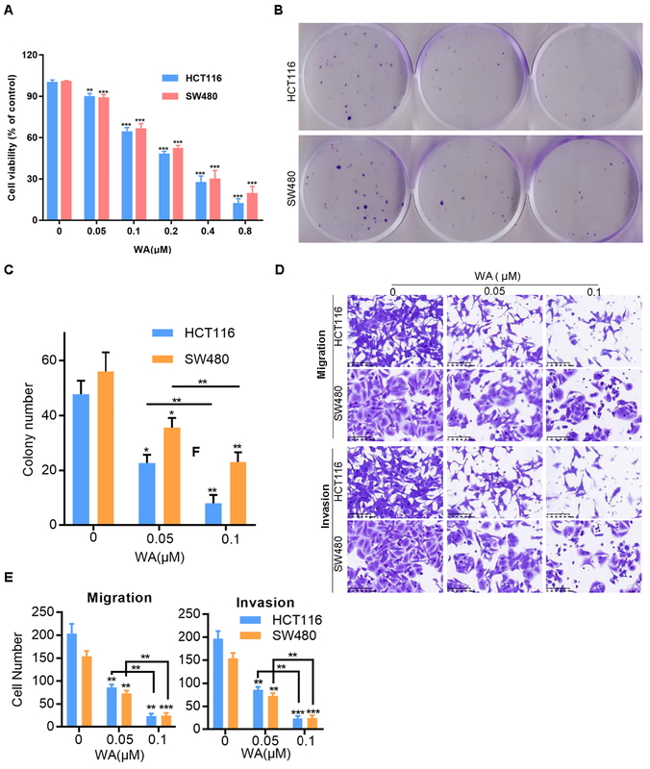

Withaferin-A inhibits colorectal cancer growth and metastasis by targeting the HSP90/HIF-1α/EMT axis
DOI: 10.5114/aoms/196381
Arch Med Sci 2025;21(4):1487-1501
Notes:
Introduction
Withaferin-A (WA) derived from natural products can inhibit the growth and metastasis of colorectal cancer (CRC) in vitro and in vivo. Transcriptome sequencing showed that WA inhibited the epithelial-mesenchymal transition pathway (EMT), HSP90, and HIF-1α genes of CRC, and further experiments showed that WA inhibited HSP90, HIF-1α, E-cadherin, and Co-IP, indicating that WA inhibits interaction between the proteins HSP90 and HIF-1α. HIF-1α knockdown reduced the migration and invasion abilities of HCT116 and SW480 cells, and in vivo experiments showed that the number of HIF-1α knockdown SW480 lung metastasis cells was significantly lower than in the control group. The classic HSP90 inhibitor, 17-AAG, can inhibit the migration and invasion of HCT116 and SW480 cells.
Material and methods
We performed Q-PCR and western blot and found that 17-AAG can inhibit HSP90 and HIF-1α of CRC.
Results
The overexpression of HSP90 on HIF-1α knockdown SW480 cells can reinstate the migration and invasion ability, HIF-1α protein expression level, and protein binding ability of HSP90 and HIF-1α in SW480 cells.
Conclusions
These findings indicate that WA inhibits CRC’s growth, migration, and invasion by inhibiting the HSP90/HIF-1α/EMT axis. Our results suggest that WA could be a potential therapeutic agent for CRC.

