Slide 1
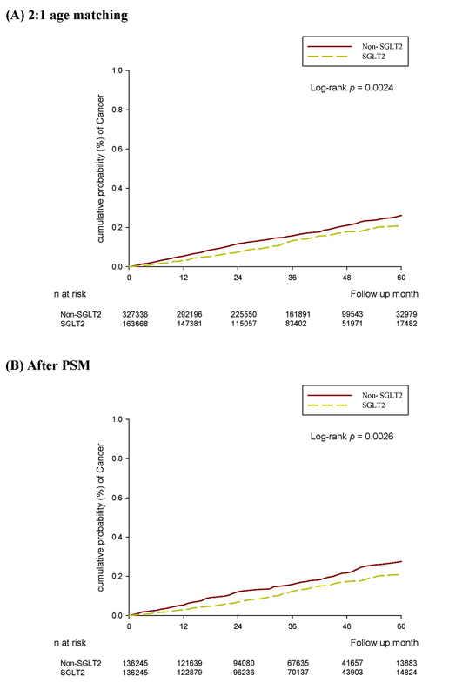

The protective effect of sodium-glucose cotransporter 2 inhibitors and the incidence of ovarian cancer: a nationwide cohort preliminary study
DOI: 10.5114/aoms/196382
Arch Med Sci 2025;21(4):1279-1288
Notes:
Introduction
Sodium-glucose cotransporter 2 (SGLT2) inhibitors are commonly used antihyperglycemic medications that also exhibit anti-inflammatory and antioxidant effects. Ovarian cancer, a common gynecological neoplasm, is associated with increased inflammation and oxidative stress. Thus, this study investigated the correlation between the usage of SGLT2 inhibitors and the incidence of ovarian cancer in a population with type 2 diabetes mellitus (T2DM).
Material and methods
A retrospective cohort study was conducted, and patients with T2DM were divided into those who used SGLT2 inhibitors and those who did not. A total of 163 668 and 327 336 patients with T2DM were categorized into the SGLT2 inhibitor and control groups, respectively. The primary outcome was the development of ovarian cancer, as identified using diagnostic codes and laboratory examination findings. Cox proportional hazard regression was adopted to yield the adjusted hazard ratios (aHRs) with 95% confidence intervals (CIs) for ovarian cancer events between the two groups.
Results
A total of 167 and 222 patients developed ovarian cancer in the SGLT2 inhibitor and control groups, respectively. The incidence of ovarian cancer was significantly lower in the SGLT2 inhibitor group than in the control group (adjusted hazard ratio: 0.73, 95% CI: 0.60–0.89, p = 0.0023). Subgroup analysis stratified by oral medications revealed that the effect of SGLT2 inhibitors on ovarian cancer development was significantly different from the effects of biguanides, sulfonylureas, -glucosidase inhibitors, and dipeptidyl peptidase-4 inhibitors (p < 0.05).
Conclusions
This preliminary study showed that the administration of SGLT2 inhibitors in patients with T2DM is associated with a lower incidence of ovarian cancer.

