Slide 1
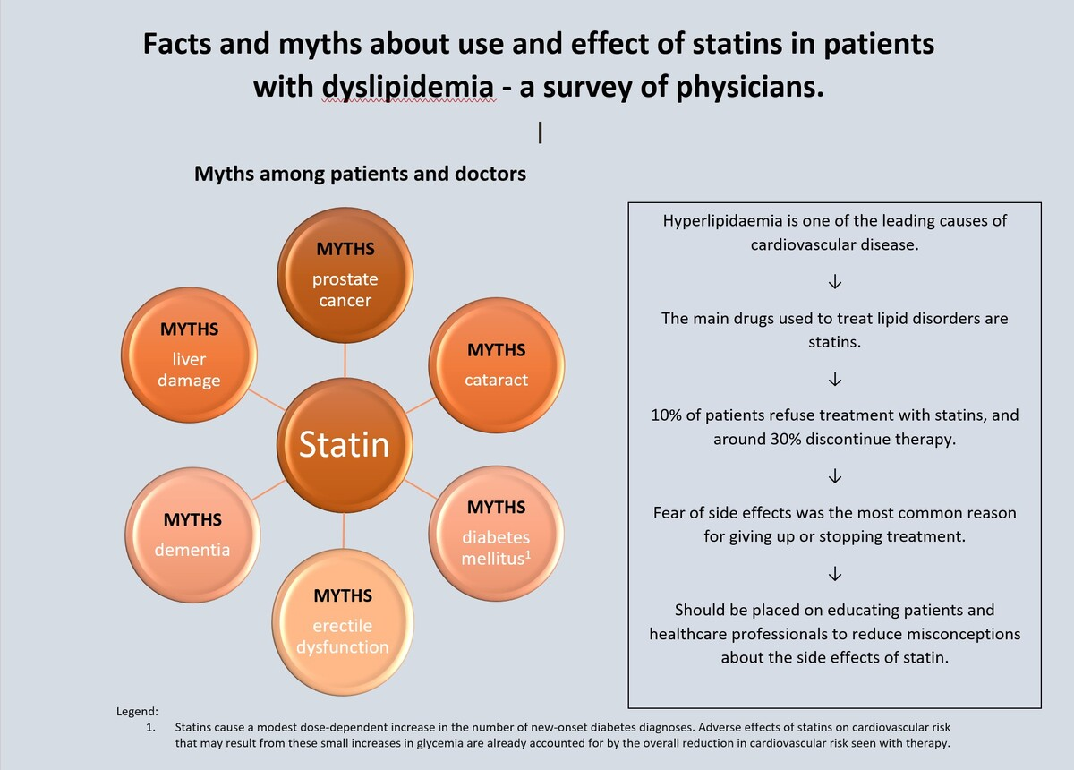

Facts and myths about the use and effects of statins in patients with dyslipidaemia: a survey of physicians
DOI: 10.5114/aoms/196806
Arch Med Sci 2026;22(1):56-64
Notes:
Introduction
Statins are the primary medications used to treat lipid disorders. However, numerous myths surrounding statin therapy lead to patient non-adherence and therapy discontinuation. The aim of this study was to assess the most common patient concerns regarding statin use.
Material and methods
A survey was conducted targeting doctors using an online questionnaire The first section included questions regarding socio-economic status, while the second focused on patient experiences related to refusing statin treatment due to fears of specific side effects, encounters with side effects during therapy, and estimates of the percentage of patients who discontinue treatment. The concluding section addressed the most common reasons for treatment termination from the perspective of practitioners, along with efforts to educate their patients.
Results
260 questionnaires were collected. Notably, 84% and 81% of doctors reported encountering refusals of statin treatment due to patients’ fears of liver and muscle damage, respectively. The majority of respondents indicated that 10–20% of patients discontinue treatment on their own, despite significant side effects occurring in less than 10% of cases. Muscular symptoms were cited as the reason for discontinuing therapy in 75% of cases, while misinformation regarding statin side effects contributed to 53% of discontinuations. Additionally, 96.5% of doctors reported making efforts to educate their patients about statins.
Conclusions
Many harmful beliefs about the side effects of statins persist among patients, resulting in non-adherence to treatment. The most prevalent concerns involve fears related to muscle and liver damage. These issues can be mitigated through targeted education for both patients and healthcare professionals.

