Slide 1
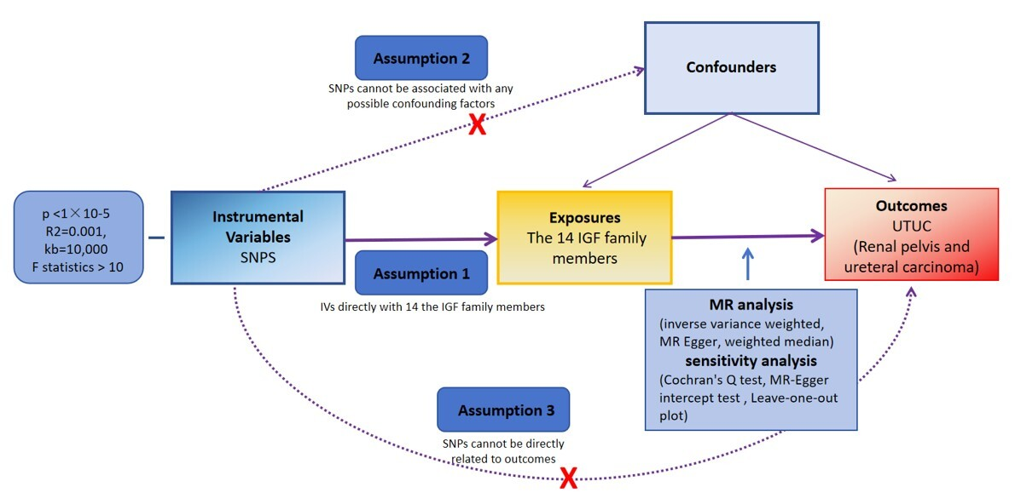

Association between the IGF family members and UTUC: a Mendelian randomization study
DOI: 10.5114/aoms/196850
Notes:
Introduction
Material and methods
Results
Conclusions

