Slide 1
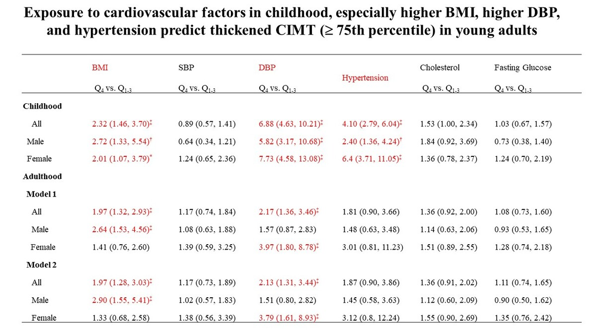

Trajectories of cardiovascular risk factors during childhood as predictors of subclinical atherosclerosis in young adults
DOI: 10.5114/aoms/196908
Notes:
Introduction
Studies on cardiovascular risk factors in childhood/adolescence and subclinical cardiovascular disease in young Asian adults remain limited. The aim of this study was to investigate the effects of childhood cardiovascular risk factors as predictors of subclinical atherosclerosis in young adults.
Material and methods
From a sample of children of school-going age enrolled in the Young Taiwanese Cohort (YOTA) Study conducted in Taipei, Taiwan, who completed the mass urine screening program between 1992 and 2000, we included 303 subjects with hypertension and 486 subjects with a normal blood pressure during childhood (2006–2008). In total, 789 young adults (mean age: 21.32 years) underwent carotid duplex to measure carotid intima-media thickness (CIMT).
Results
The major cardiovascular risk factors during childhood significantly predicted CIMT in adulthood. After adjusting for covariates, multivariate linear regression analysis showed that childhood cardiovascular risk factors such as male sex, increased body mass index (BMI), elevated diastolic blood pressure (DBP), raised fasting glucose, and abnormal cholesterol profiles predict subclinical atherosclerosis (CIMT ≥ 75th percentile) in young adulthood after a mean follow-up period of 8.5 years. Multivariate-adjusted odds ratios (95% confidence interval) for risk factors in childhood (the upper quartile vs. lower three quartiles) significantly predicting thickened CIMT (≥ 75th percentile) were 2.32 (1.46–3.70) for BMI, 6.88 (4.63–10.21) for DBP, and 4.10 (2.79–6.04) for childhood with hypertension.
Conclusions
This study highlights the importance of prevention and management of cardiovascular risk factors during childhood for the primary prevention of cardiovascular disease in adulthood.

