Slide 1
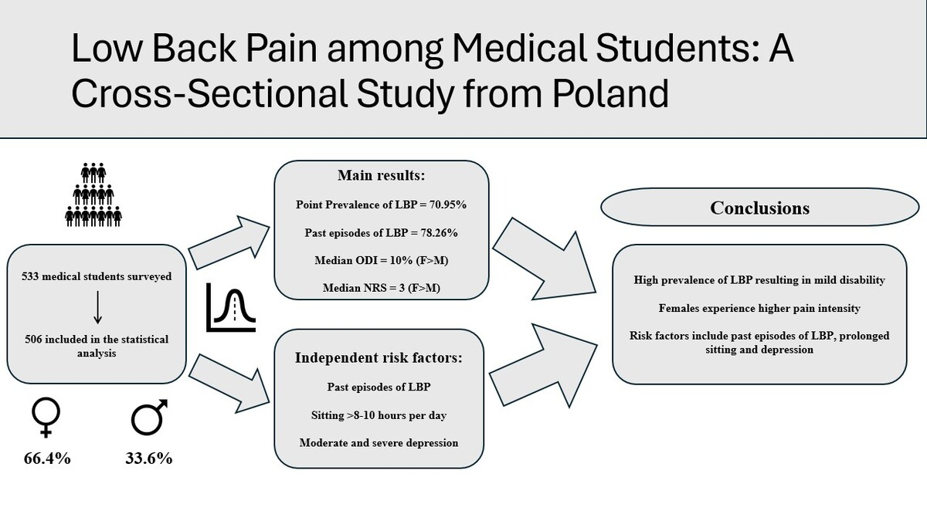

Low back pain among medical students: a cross-sectional study from Poland
DOI: 10.5114/aoms/196934
Arch Med Sci 2025;21(6):2450-2458
Notes:
Introduction
Low back pain (LBP) is a common condition and the leading cause of disability worldwide. Medical students may be at higher risk due to prolonged sitting and stress. The aim of this study was to examine the prevalence of LBP and disability among Polish medical students and identify associated risk factors.
Material and methods
In this study, 533 medical students, predominantly female (66.4%), with a median age of 22, were surveyed via an online questionnaire. The survey used the Oswestry Disability Index (ODI) and Patient Health Questionnaire (PHQ-9) to evaluate LBP and depression symptoms. Demographic data and information on smoking, exercise, sitting duration, spine posture, past and present LBP, pain duration, intensity, and analgesic use were also collected.
Results
Point prevalence LBP was 70.95%, while 78.26% of participants reported past history of LBP. The median LBP intensity measured with the Numeric Rating Scale (NRS) was 3, and the median ODI score was 10%. Overall, female medical students suffered more from LBP than males (66.4% vs. 33.6%). The following LBP risk factors were identified in the studied group: past episodes of LBP (OR = 2.92), sitting 8 h/day (OR = 2.44), as well as 10 h or more (OR = 2.95), moderate and severe depression symptoms (OR = 2.51, OR = 7.33 respectively).
Conclusions
Prevalence of low back pain among medical students in the studied group is high, resulting in mild disability, with females experiencing more severe symptoms than males. Past LBP episodes, sitting 8 h or more, and depression symptoms are independent risk factors for development of LBP among Polish medical students.

