Slide 1
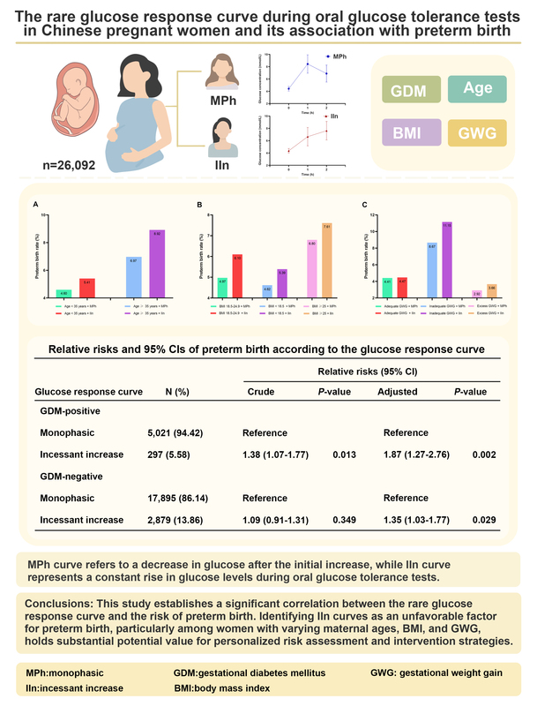

The rare glucose response curve during oral glucose tolerance tests in pregnant Chinese women and its association with preterm birth
DOI: 10.5114/aoms/196989
Arch Med Sci 2026;22(1):195-207
Notes:
Introduction
This study aimed to investigate the rare glucose response curve during oral glucose tolerance tests (OGTTs) in pregnant Chinese women and its association with preterm birth.
Material and methods
A total of 26,092 pregnant women were included in this study and categorized into two groups based on the shape of their glucose response curve during OGTTs conducted at 24–28 weeks of gestation. The curves were classified as either monophasic (MPh) or incessant increase (IIn). Logistic regression analysis was utilized to examine the association between these shapes and the risk of preterm birth. Additionally, we explored the relationship between these shapes and preterm birth across various factors including gestational diabetes mellitus (GDM) status, maternal age, preconception body mass index (BMI), and gestational weight gain (GWG).
Results
The most prevalent OGTT curve observed was MPh (85.54%), followed by IIn (14.46%). Compared to the majority MPh group, curves with IIn had a higher rate of preterm birth (p < 0.05). The logistic regression analyses, with the MPh group as a reference, revealed that regardless of GDM, membership of the IIn group was an unfavorable factor for preterm birth development, even after adjusting for potential covariates (p < 0.05). Furthermore, these risks varied depending on maternal age, preconception BMI, and GWG.
Conclusions
This study establishes a significant correlation between the rare glucose response curve and the risk of preterm birth. Identifying IIn curves as an unfavorable factor for preterm birth, particularly among women with varying maternal ages, BMI, and GWG, holds substantial potential value for personalized risk assessment and intervention strategies.

