Slide 1
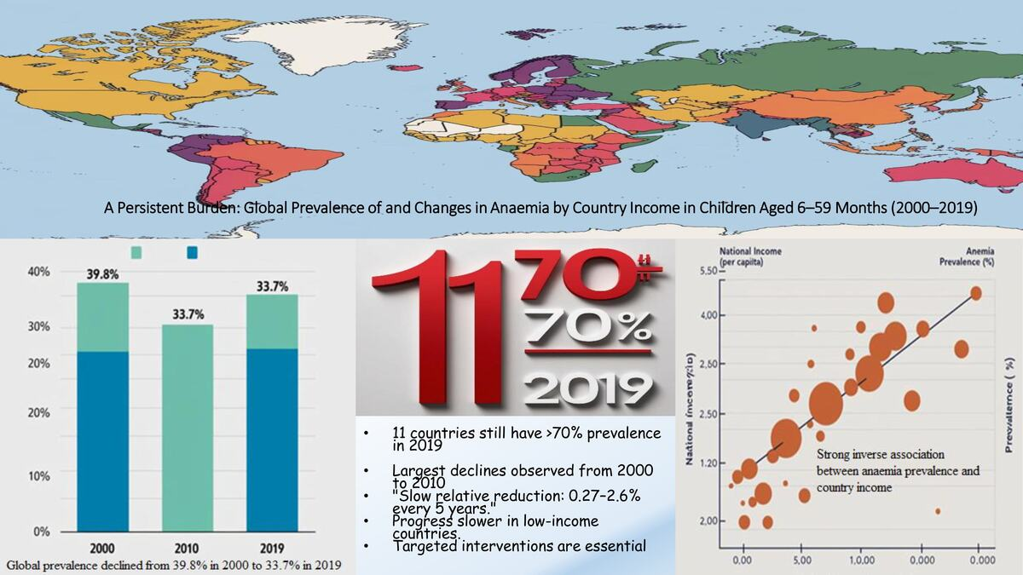

A persistent burden: global prevalence of and changes in anaemia by country income in children aged 6–59 months (2000–2019)
DOI: 10.5114/aoms/197062
Arch Med Sci 2026;22(1):208-215
Notes:
Introduction
Anaemia is a major health concern worldwide. A comprehensive analysis of the global prevalence of anaemia is essential for creating suitable strategies to achieve global disease control goals. This study aimed to examine the prevalence of and changes in anaemia in children on a global scale. The results were stratified by country income.
Material and methods
We analysed the prevalence of anaemia among children aged 6–59 months in 189 countries from 2000 to 2019 using data collected by the World Health Organization (WHO). We compared this prevalence with the income earned by each country in 2022. Finally, we calculated the changes in each country’s anaemia burden throughout the study period.
Results
In 2019, 33.7% of children aged 6–59 months were anaemic globally, compared to 39.8% in 2000. In 2019, the prevalence of anaemia in children exceeded 70% in 11 countries. Anaemia prevalence differed across geographic regions, with the highest incidences observed in Africa and Southern Asia. Our analysis indicated a highly significant association between prevalence of anaemia and country income (p < 0.001). This significance was persistent throughout the study period. The greatest decline in anaemia prevalence was observed between 2000 and 2010.
Conclusions
The highest incidence of anaemia was noted in low-income countries. Progress in reducing anaemia among children aged 6–59 months was observed globally, regionally, and in almost every country. Nevertheless, the prevalence of anaemia in children remains significant.

