Slide 1
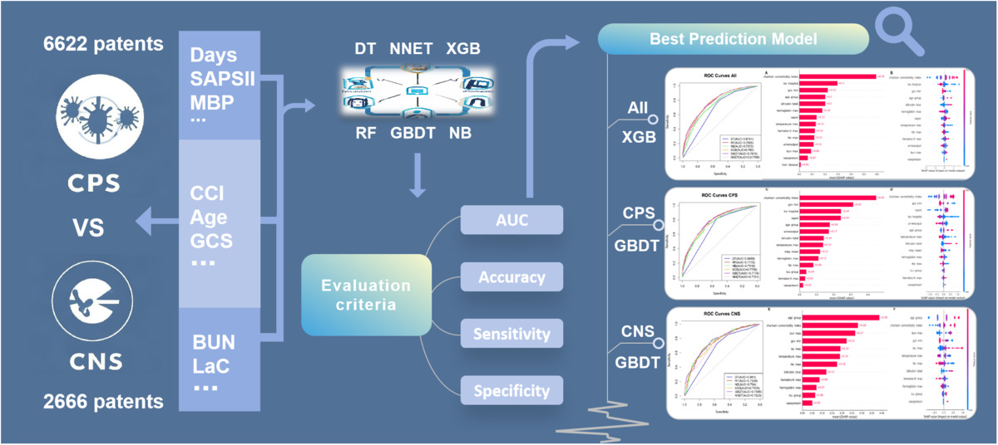

Machine learning for prediction of in-ICU mortality in sepsis: an observational study using the MIMIC IV database
DOI: 10.5114/aoms/197307
Arch Med Sci 2026;22(1):270-281
Notes:
Introduction
The aim of the study was to identify the key risk factors influencing in-intensive care unit (ICU) mortality of patients with sepsis and develop prognosis prediction models for culture-positive sepsis (CPS) and culture-negative sepsis (CNS) patients.
Material and methods
Data were extracted from the MIMIC-IV database, which included 9288 patients with sepsis. The whole sample was divided into CPS (6622 patients) and CNS groups (2666 patients). We established six machine learning models – DT, RF, NB, XGB, GBDT, and NNET – to predict in-ICU death for all study samples, as well as for CPS and CNS subgroups. Model performance was assessed using AUC, accuracy, sensitivity, and specificity. SHapley Additive exPlanations (SHAP) values were used to explain the effect of variables on model results.
Results
The in-ICU mortality rate was 54.58% for the whole study sample; the difference in in-ICU mortality between the CPS (55.19%) and CNS (53.04%) groups was not statistically significant. The main significant influential factors identified included Charlson Comorbidity Index (CCI), number of days in hospital, Glasgow Coma Scale (GCS), older age, and total bilirubin (TBil). The XGB model performed best in the overall sample (AUC = 0.782), while the GBDT model was most effective for the CPS group (AUC = 0.7813) and the CNS group (AUC = 0.7582).
Conclusions
This study identified key risk factors for in-ICU death in patients with sepsis and highlighted differences in clinical characteristics between patients with CPS and CNS. These findings may contribute to the development of personalized treatment strategies and risk assessment, thereby improving the prognosis of septic patients, especially patients with CNS.

