Slide 1
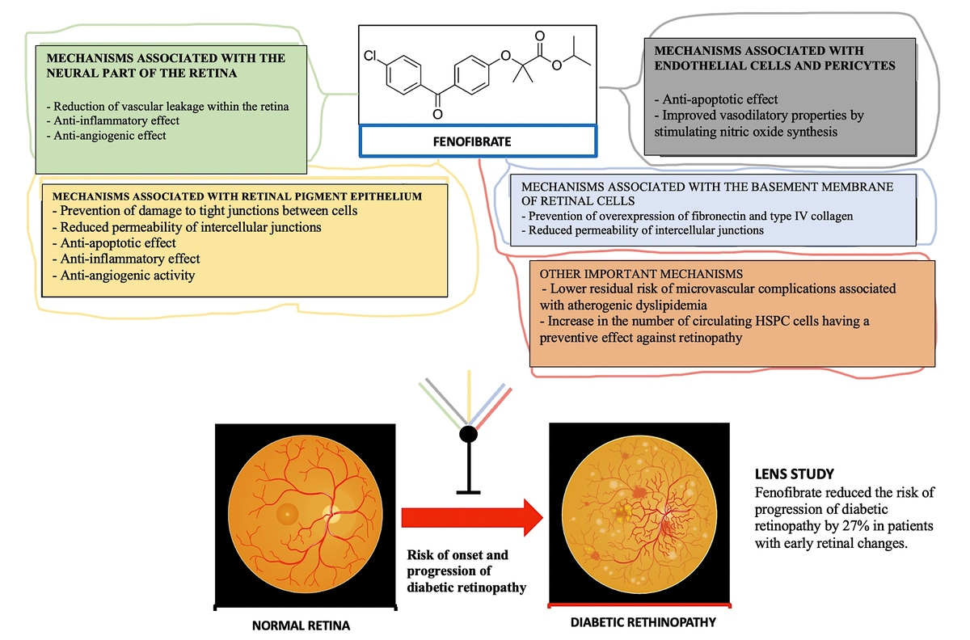

The prevention opportunities of retinopathy in diabetic patients – position paper endorsed by the Polish Lipid Association
DOI: 10.5114/aoms/197331
Arch Med Sci 2024;20(6):1754-1769
Notes:
Cardiovascular diseases (CVD) prevention does not only mean effective fight against the existing and well-recognized cardiovascular risk factors, but also against their complications, including micro- and macrovascular complications. Only then we might comprehensively reduce CVD burden and cardiovascular and cause-specific morbidity and mortality. In relation to obesity, prediabetes and especially diabetes, we recognize a number of potential dangerous non-cardiovascular complications, such as neuropathy, nephropathy and retinopathy. The latter’s prevalence is even 30–40% and may appear in as many as 15% of patients with prediabetes. If not treated well it might result in the need for eye surgery or even vision loss. Fenofibrate has had a long history of evidence suggesting its preventive role in primary and especially secondary prevention of retinopathy, what has been investigated since the FIELD trial 19 years ago. Thus, given the obesity (the prevalence of 30% in Poland) and diabetes (10% which is predicted to be doubled in next 25 years) epidemic, we should look for the effective methods not only to optimize fasting blood glucose and haemoglobin A1C, but also atherogenic dyslipidaemia and their complications, including retinopathy. In this Position Paper by the Polish Lipid Association (PoLA) we have reviewed the current stage of knowledge on possible mechanisms by which fenofibrate may contribute to retinopathy prevention, available data on safety and efficacy, to finally recommend administering fenofibrate in prevention of this dangerous diabetic complication, which significantly affects quality of life and disability-adjusted life-years (DALY). This intervention – well-recognized and already in common use in diabetic patients – may significantly improve population health in Poland and worldwide.

