Slide 1
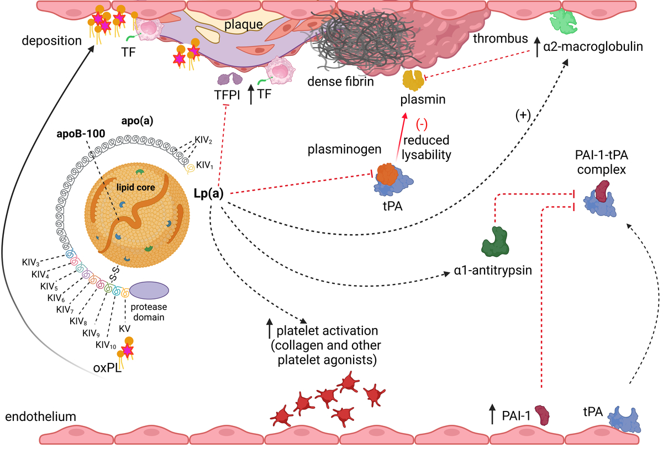

Lipoprotein(a) and thromboembolism: current state of knowledge and unsolved issues
DOI: 10.5114/aoms/197357
Arch Med Sci 2024;20(6):1770-1783
Notes:
Lipoprotein(a) [Lp(a)], a low-density lipoprotein-like particle containing a highly polymorphic apolipoprotein(a) [apo(a)] homologous in > 80% to plasminogen, was identified as a genetically determined independent risk factor for cardiovascular disease. Elevated Lp(a) levels, found in about 20% of Europeans, are strongly linked to higher rates of myocardial infarction, major adverse cardiac events, accelerated plaque progression, ischemic stroke (especially in younger adults), and calcific aortic valve disease. However, its role in venous thromboembolism, including atypical locations like cerebral and retinal vein thrombosis, remains controversial despite several shared mechanisms underlying arterial and venous thromboembolism. The most robust evidence supports antifibrinolytic properties of elevated Lp(a), particularly smaller apo(a) isoforms, which inhibit plasminogen activation mainly by interacting with the tissue-type plasminogen activator, plasminogen, and fibrin. Other prothrombotic mechanisms include increased synthesis of plasminogen activator inhibitor (PAI-1), formation of denser fibrin networks composed of thinner fibers, less susceptible to lysis, increased platelet activation, enhanced oxidation of phospholipids leading to a low-grade proinflammatory state, upregulated tissue factor expression, and suppression of tissue factor pathway inhibitor. Targeted Lp(a) lowering therapies are currently being tested in randomized clinical trials and could potentially have clinically relevant antithrombotic effects, evidenced by the reduced risk of thromboembolism. This review summarizes the available data on the prothrombotic and antifibrinolytic actions of Lp(a), along with clinical evidence for the increased risk of thromboembolic events related to elevated Lp(a). It also introduces new concepts to explain discrepant clinical results regarding venous events, highlighting the impact of oxidized phospholipids on a prothrombotic state under conditions of high Lp(a).

