Slide 1
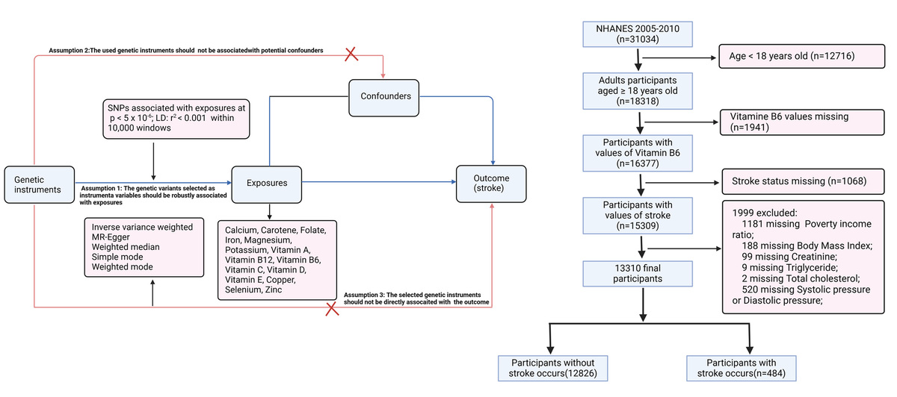

Circulating micronutrients and risk of stroke: a Mendelian randomisation and cross-sectional observational study
DOI: 10.5114/aoms/199337
Arch Med Sci 2024;20(6):2034-2038
Notes:
Introduction
Material and methods
Results
Conclusions

