Slide 1
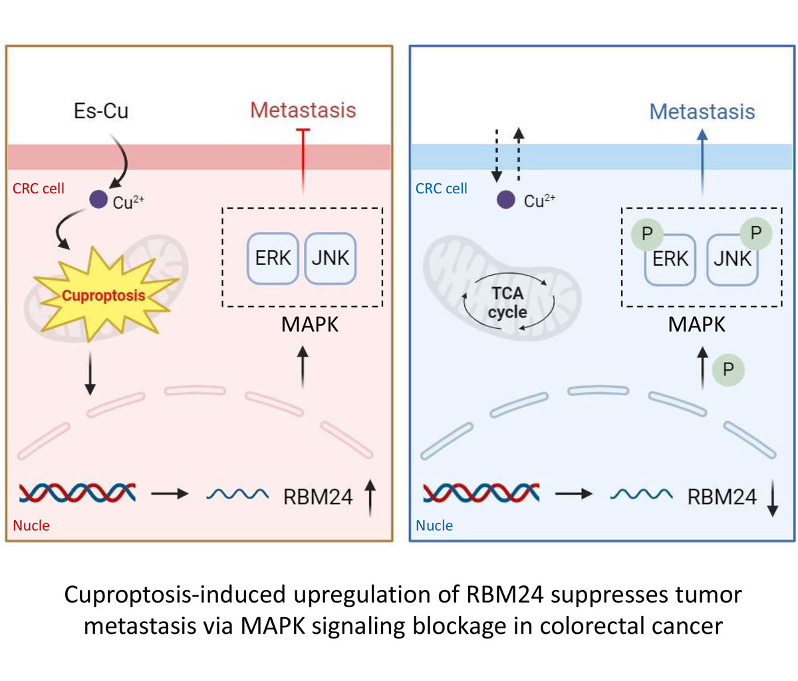

Cuproptosis-induced upregulation of RBM24 suppresses tumor metastasis via MAPK signaling blockage in colorectal cancer
DOI: 10.5114/aoms/199363
Arch Med Sci 2025;21(6):2545-2558
Notes:
Introduction
Cuproptosis is an emerging form of programmed cell death that has been implicated in tumor progression. Nevertheless, the relationship between cuproptosis and the metastatic process in colorectal cancer (CRC) remains obscure, as are the underlying molecular mechanisms that drive CRC progression in this process.
Material and methods
Bioinformatics, quantitative reverse transcription polymerase chain reaction (qRT-PCR), immunofluorescence (IF), and Western blot (WB) were leveraged to analyze the expression levels of RBM24 in CRC. Cell Counting Kit-8 (CCK-8) assay, Transwell, and WB assays were conducted to determine the cell proliferation, migration, and invasive potential, alongside the expression analysis of metastasis-related proteins. Intracellular Cu2+ levels were quantified using a Copper Assay Kit. Additionally, the expression of mitogen-activated protein kinase (MAPK) pathway and cuproptosis-related proteins were probed via WB.
Results
RBM24 was under-expressed in CRC, and its forced expression inhibited the metastatic abilities of CRC cells, including migration, invasion, and epithelial-mesenchymal transition (EMT). The use of a MAPK pathway inhibitor could temper the pro-metastatic effects associated with low RBM24 levels. At the molecular level, the combination of copper ionophores with copper ions (Es-Cu) upregulated RBM24, leading to the inhibition of CRC cell spread. The effects of cuproptosis on CRC cells were abolished by knocking down RBM24.
Conclusions
Elevated levels of cuproptosis-induced cell death disrupt the MAPK signaling cascade, thus suppressing the metastasis of CRC. This discovery sheds new light on the potential application of cuproptosis in oncological treatments.

