Slide 1
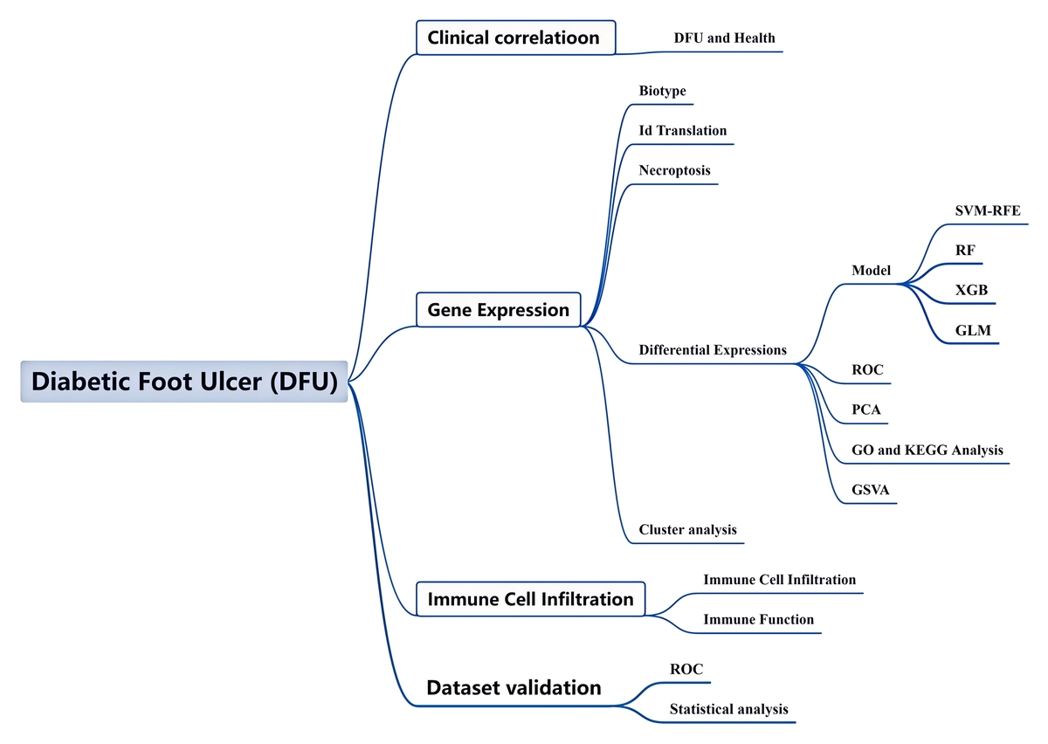

Exploring necroptosis-associated genes: implications for immune responses and therapeutic strategies in diabetic foot ulcers
DOI: 10.5114/aoms/199504
Arch Med Sci 2026;22(1):325-344
Notes:
Introduction
Diabetic foot ulcers (DFUs) are among the most severe and debilitating diabetic complications, often leading to extremely high morbidity and mortality. Recently, increasing evidence has highlighted the role of necroptosis, a distinct type of programmed cell death distinct from apoptosis, in the progression and severity of DFUs. Understanding necroptosis-associated genes in DFUs could open new therapeutic avenues aimed at modulating this form of cell death, potentially improving outcomes for patients suffering from this serious diabetic complication.
Material and methods
This study aimed to identify and confirm potential necroptosis biomarkers associated with DFU through the application of machine learning and bioinformatics approaches. We obtained three microarray datasets associated with DFU patients from the Gene Expression Omnibus (GEO) database: GSE68183, GSE134431, and GSE80178.
Results
In GSE134431, we identified necroptosis-associated genes (NRGs) with differential expression between DFU patients and healthy controls, totaling 37 NRGs. Additionally, we observed an activated immune response in both groups. Moreover, clustering analysis identified two distinct clusters within the DFU samples, highlighting immune heterogeneity. Subsequently, we constructed a random forest (RF) model using 5 genes (CENPB, TRIM56, ZNF768, PLIN4, and ATP1A1). Notably, this model demonstrated outstanding performance on the external validation datasets GSE134431, GSE68183 (AUC = 1.000). The study identified five genes linked to necroptosis in the context of DFU, revealing new potential biomarkers and targets for DFU therapy.
Conclusions
Bioinformatics analysis indicated that CENPB, TRIM56, ZNF768, PLIN4, and ATP1A1 could serve as potential biomarkers for future DFU research.

