Slide 1
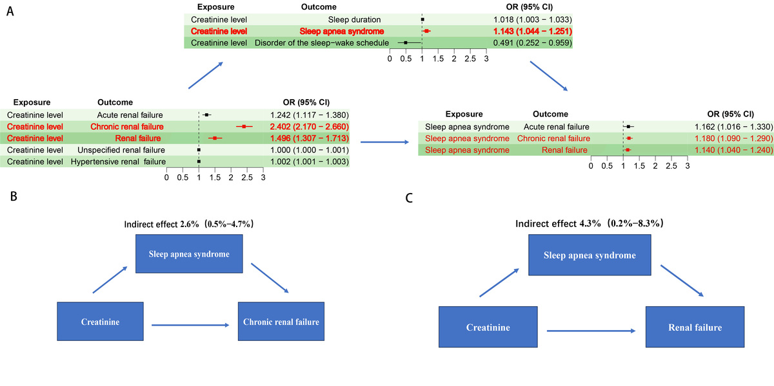

Sleep disorders and renal failure: exploring the role of creatinine and sleep apnea syndrome through cross-sectional studies and Mendelian randomization analysis
DOI: 10.5114/aoms/199512
Notes:
Introduction
The aim of the study was to explore potential factors affecting the emergence of sleep disorders in patients with renal failure.
Material and methods
A cross-sectional study approach was employed in order to evaluate the relationship between renal failure and sleep disorders, and to validate the findings through Mendelian randomization (MR) analysis. Furthermore, we utilized a two-stage MR methodology to quantify the specific contribution of creatinine, mediated by sleep apnea syndrome, to the development of renal failure.
Results
In the multivariate adjusted logistic regression analysis, compared to non-renal failure patients, time to fall asleep in minutes (OR = 0.01, 95% CI: 0.00–0.40, p = 0.022) was significantly reduced, while waking up during the night (OR = 0.73, 95% CI: 0.62–0.86, p = 0.003), feeling unrested during the day (OR = 0.65, 95% CI: 0.48–0.89, p = 0.015), and feeling overly sleepy during the day (OR = 0.67, 95% CI: 0.50–0.89, p = 0.014) were also decreased. In the study of sleep-related factors and renal failure, it was found that sleep apnea syndrome could serve as a mediating factor in mediating creatinine levels for the occurrence of chronic kidney failure (proportion mediated: 2.6%; 95% CI = 0.5–4.7%) and renal failure (proportion mediated: 4.3%; 95% CI = 0.2–8.3%).
Conclusions
Compared to non-renal failure patients, patients with renal failure exhibit significantly reduced sleep onset time and sleep stability. Sleep apnea syndrome may act as a mediator, promoting creatinine-induced damage to the kidneys.

