Slide 1
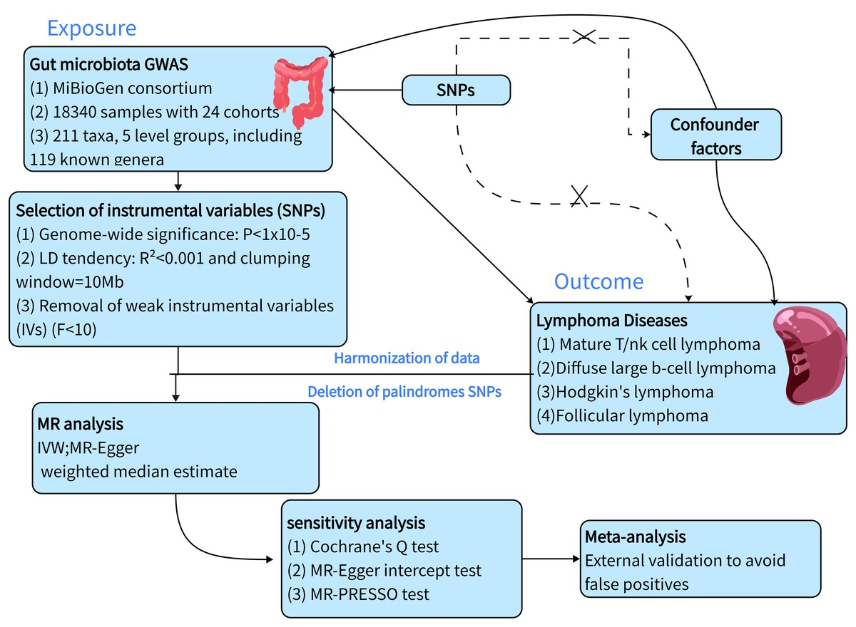

Identifying the causal relationship between gut microbiota and lymphoma disease: a Mendelian randomization study and meta-analysis
DOI: 10.5114/aoms/199574
Arch Med Sci 2026;22(1):476-487
Notes:
Introduction
Increasing evidence from observational studies and clinical trials suggests that gut microbiota (GM) are associated with lymphoma. However, it is unclear whether there is a causal relationship between GM and lymphoma.
Material and methods
To evaluate the causal relationship between GM and lymphoma, we conducted a two-sample Mendelian randomization analysis based on the genome-wide association study (GWAS). GWAS summary statistics of the GM were obtained from the MiBioGen study that including 211 taxa. GWAS summary statistics of four lymphomas were obtained from the IEU Open GWAS study. Then, we systematically performed sensitivity analyses and heterogeneity analysis to verify the reliability of our findings. Finally, we used an external cohort for validation and performed a meta-analysis of the positive results.
Results
We identified 37 causal relationships between GM and lymphoma. The results of the sensitivity analyses demonstrated the reliability of the MR analysis. Furthermore, the combined meta-analysis yielded nine significant results, with the most notable being Terrisporobacter (MetaOR = 2.39, 95% CI = 1.07–5.32, p = 0.03), which was identified as a pathogenic factor for diffuse large B-cell lymphoma (DLBCL). Methanobrevibacter (MetaOR = 0.49, 95% CI = 0.27–0.92, p = 0.03) was identified as a protective factor against DLBCL. Cyanobacteria (MetaOR = 1.94, 95% CI = 1.24–3.03, p = 0.004) were identified as a pathogenic factor for FL.
Conclusions
Our study identified a causal relationship between gut microbes and four lymphoma diseases. To further confirm the causal relationship, external validation was performed, thereby providing new insights into the subsequent mechanisms by which gut microbes mediate lymphoma development.

