Slide 1
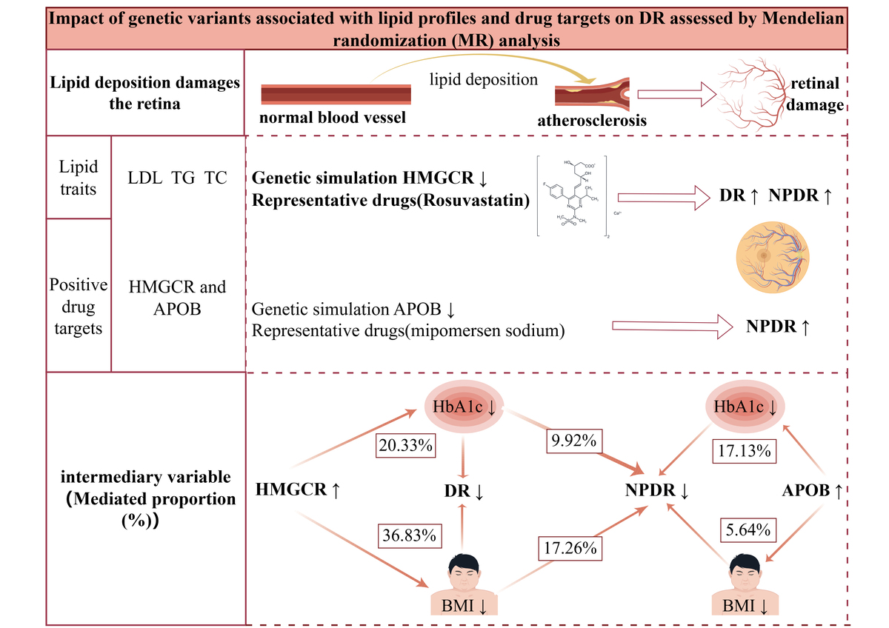

Impact of lipid-lowering drug targets on genetic associations with diabetic retinopathy
DOI: 10.5114/aoms/199622
Arch Med Sci 2025;21(4):1152-1163
Notes:
Introduction
Lipid metabolism is pivotal in diabetic retinopathy (DR) development. Nevertheless, the relationship between lipid-lowering drugs and the risk of DR remains a topic of debate. This study employed Mendelian randomization (MR) to investigate the potential effects of pharmacological lipid-lowering targets on DR and to clarify the causal association between blood lipid characteristics and DR.
Material and methods
The data comprised genetic variations related to lipid traits and genetic variations associated with lipid-lowering drug targets obtained from the Global Lipid Consortium. Total DR, non-proliferative DR (NPDR), and proliferative DR (PDR) were sourced from the Finnish R9 database. Lipid-lowering drug targets were tested using inverse variance-weighted MR (IVW-MR) and statistics-based MR (SMR). Colocalization and mediation analysis were conducted to validate the results and explore potential mediating factors.
Results
A reduced risk of total DR and NPDR was associated with genetically improved 3-hydroxy-3-methylglutaryl-CoA reductase (HMGCR) (OR = 0.62; 95% CI: 0.46–0.83; <i>p</i> = 1.30 × 10<sup>–2</sup>; OR = 0.49; 95% CI: 0.34–0.70; <i>p</i> = 9.70 × 10<sup>–4</sup>). Strong colocalization (PP.H4 = 0.85) was observed between whole blood tissue HMGCR expression and a significant MR relationship with total DR (OR = 0.66; 95% CI: 0.52–0.85; <i>p</i> = 7.31 × 10<sup>–4</sup>). Furthermore, body mass index (BMI) and glycated hemoglobin (HbA1c) are critical factors that mediate the impact of HMGCR and apolipoprotein B (APOB) on DR risk.
Conclusions
This Mendelian randomization study suggests that abnormalities in triglyceride (TG) levels serve as a pathogenic element in DR. Of the nine lipid-lowering drug targets assessed, HMGCR and APOB have emerged as potential promising targets for managing NPDR. These findings underscore the importance of controlling both BMI and HbA1c levels to optimize outcomes in diabetic patients at risk for DR. The therapeutic mechanisms of HMGCR and APOB in DR go beyond lipid lowering alone, and a multimodal lipid-lowering strategy should be selected early and comprehensively to address the patient’s medical conditions.

