Slide 1
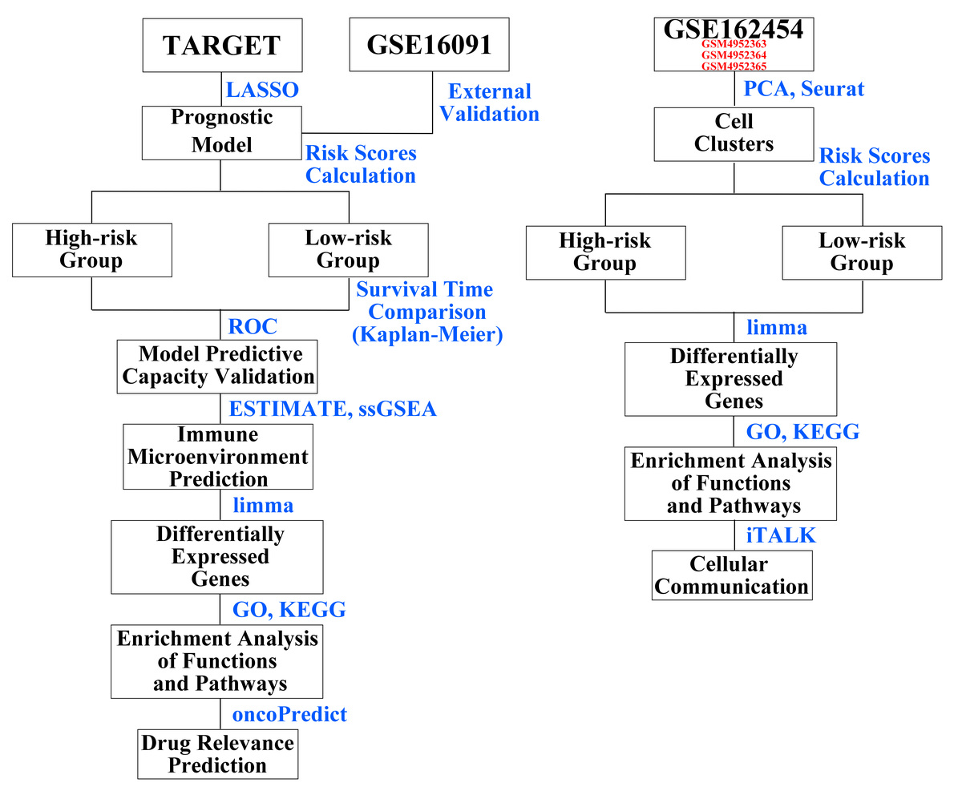

An immune escape-related gene signature for predicting the prognostic and immune microenvironment in osteosarcoma
DOI: 10.5114/aoms/199786
Notes:
Introduction
This study aimed to develop an immune escape-related gene signature for prognostic prediction and clarification of the immune microenvironment in osteosarcoma, a predominant malignant bone tumor in pediatric and adolescent populations.
Material and methods
This study used transcriptomic and genomic data from various databases (Therapeutically Applicable Research to Generate Effective Treatments and Gene Expression Omnibus). A prognostic model was established using the least absolute shrinkage and selection operator method, followed by rigorous statistical analysis. Additionally, the study involved the investigation of differential pathways and single-cell data analysis to understand the immune escape mechanisms in osteosarcoma.
Results
The study successfully developed an immune escape-related gene model that stratifies patients with osteosarcoma into different prognostic groups with significant survival differences. It indicated that higher immune escape-related gene scores were associated with poor survival outcomes. Additionally, the model demonstrated efficacy in predicting the complexity and variability of the immune microenvironment in osteosarcoma, correlating with different immune cell infiltrations and immunotherapy responses. Furthermore, single-cell analysis revealed distinct molecular signatures and pathways associated with immune escape, emphasizing potential therapeutic targets in osteosarcoma management.
Conclusions
The immune escape-related gene model provides a novel approach to understanding and predicting osteosarcoma prognosis. This model serves as a valuable tool for determining potential therapeutic targets and developing personalized treatment strategies. It emphasizes the importance of immune escape mechanisms in osteosarcoma progression and treatment.

