Slide 1
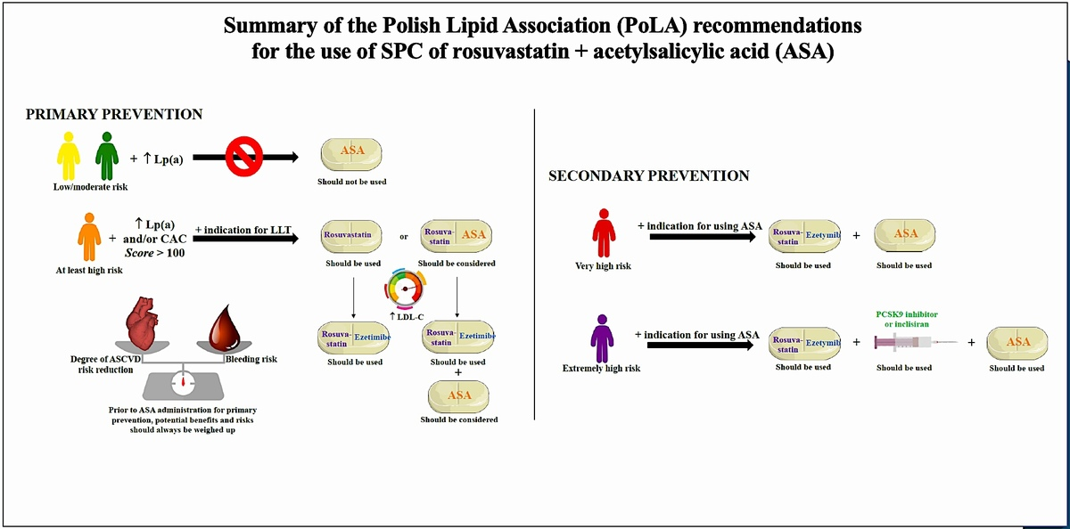

Rosuvastatin-based combination treatment with acetylsalicylic acid or ezetimibe in the management of patients at high and very high cardiovascular risk. Expert opinion paper of the Polish Lipid Association 2025
DOI: 10.5114/aoms/199826
Arch Med Sci 2025;21(1):1-15
Notes:
Lipid disorders are the most common risk factor for atherosclerotic cardiovascular disease (ASCVD) in Poland, where it is responsible for up to 200,000 deaths per year, with the number of myocardial infarctions and strokes reaching 80,000 annually and 25% of people dying within 3 years after a myocardial infarction. Despite the availability of effective drugs, the level of control of low-density lipoprotein cholesterol (LDL-C) is low, at only about 20% among high- and very high-risk patients, who often require combination lipid-lowering therapy (LLT) with a potent statin (e.g. rosuvastatin) and ezetimibe. Moreover, in Poland, several million patients require concomitant lipid-lowering and antiplatelet (acetylsalicylic acid) therapy based on their risks and indications. Single pill combinations (SPCs) improve adherence to treatment as well as the achievement of therapeutic goals and allow a greater reduction in cardiovascular incidents and mortality. This expert opinion paper, endorsed by the Polish Lipid Association (PoLA), provides practical recommendations for more effective treatment of patients with indications for LLT and antiplatelet therapy using available rosuvastatin-based combination therapies (with ezetimibe or acetylsalicylic acid).

