Slide 1
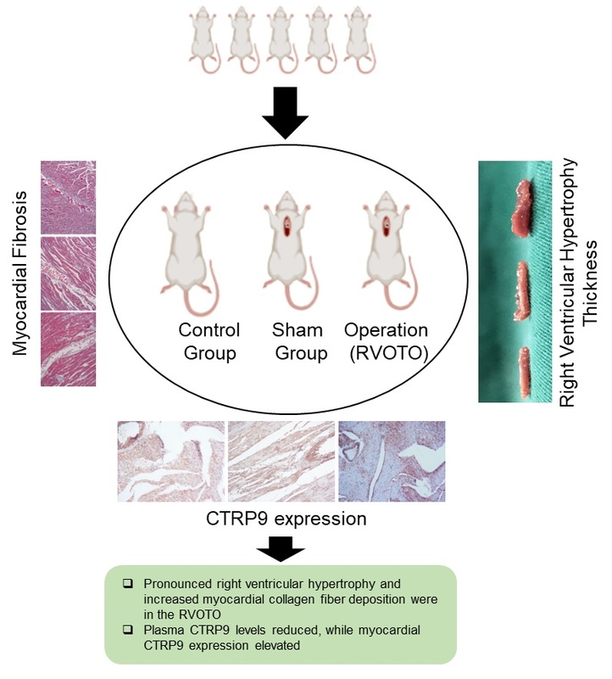

Correlative study on the expression of adipokine CTRP9 in a rat model of right ventricular outflow tract obstruction
DOI: 10.5114/aoms/199929
Notes:
Introduction
Right ventricular outflow tract obstruction (RVOTO) is linked to right ventricular hypertrophy and fibrosis, which can lead to significant cardiovascular complications. C1q-tumor necrosis factor-related protein-9 (CTRP9) may serve as a biomarker for cardiac remodeling. This study examined CTRP9 expression in a rat model of RVOTO and its association with hypertrophy and fibrosis.
Material and methods
Thirty male Sprague Dawley rats were divided into three groups: operation, sham operation, and control (10 rats each). The operation group underwent pulmonary arterial constriction, while the sham group had thoracotomy without pulmonary arterial constriction. After 4 weeks, heart specimens were collected for plasma CTRP9 quantification with ELISA, myocardial thickness measurement, and collagen fiber volume assessment. CTRP9 expression was analyzed using immunohistochemistry and Western blot. Statistical evaluations included t-tests and Pearson correlation analysis.
Results
The operation group showed a significantly (p < 0.001) higher collagen fiber volume ratio in right ventricular hypertrophy than the sham and control groups, indicating notable myocardial fibrosis. CTRP9 levels in plasma were significantly lower in the operation group (p < 0.001) as compared to the sham and control groups. Moreover, plasma CTRP9 showed a negative correlation with hypertrophy (r = –0.910, p = 0.029). Western blotting and immunohistochemical analysis confirmed significantly higher myocardial CTRP9 concentrations in the operation group compared to the sham (p = 0.032) and control (p = 0.029) groups, correlating strongly with hypertrophy (r = 0.948, p = 0.036) and fibrosis (r = 0.947, p = 0.027) respectively.
Conclusions
In this RVOTO model, decreased circulating plasma CTRP9 levels were observed alongside increased myocardial expression, suggesting a vital role for CTRP9 in the pathological processes of right ventricular hypertrophy during the remodeling process.

