Slide 1
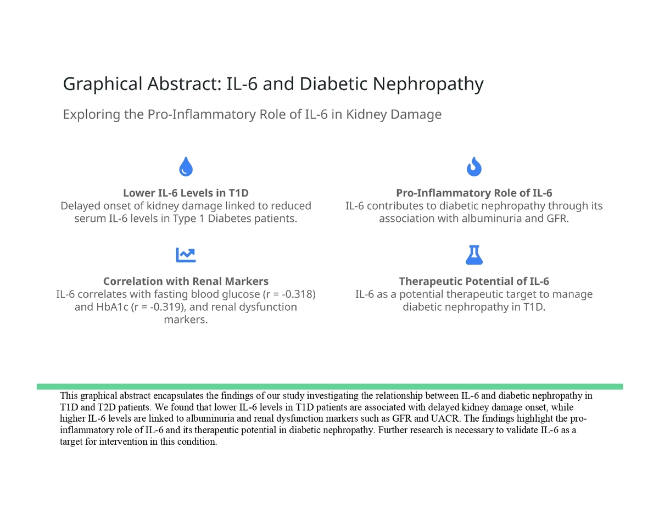

Interleukin 6: friend or foe in diabetic nephropathy?
DOI: 10.5114/aoms/200105
Arch Med Sci 2025;21(4):1180-1190
Notes:
Introduction
This study aimed to investigate the relationship between serum cytokine levels, particularly interleukin 6 (IL-6), and diabetic nephropathy (DN) in patients with type 1 (T1D) and type 2 diabetes (T2D).
Material and methods
A cross-sectional study was conducted among 200 patients diagnosed with either T1D or T2D from January 2022 to December 2023 at the Endocrinology and Diabetes Department of Madinah Hospital, Saudi Arabia.
Results
A total of 200 individuals with T1D (n = 100) or T2D (n = 100) were enrolled in this research. Male patients (54%) and those aged 30–50 (67.5%) dominated the cohort. About 50% had diabetes for less than 10 years, and 49.5% were overweight. 63.5% (n = 117) had a reduced glomerular filtration rate (GFR), whereas 46% (n = 92) had albuminuria. T1D patients were mostly normal weight, while T2D patients were overweight or obese. Both diabetes types had identical kidney damage stages. T1D patients were more likely to have moderately elevated albuminuria (53% vs. 37%, p < 0.05) than T2D individuals. T1D patients had considerably lower serum cytokine levels than T2D patients. IL-6 levels were moderately correlated with fasting blood glucose (FBG) (r = –0.318, p < 0.01) and HbA1c (r = –0.319, p < 0.01) in T1D patients. IL-6 had a modest correlation with renal dysfunction markers including GFR and urine albumin-creatinine ratio (UACR) (r = –0.250, p < 0.05 and r = 0.338, p < 0.001, respectively). In T1D patients there was a weak but significant correlation between GFR and IL 6.
Conclusions
Lower serum IL-6 levels in T1D patients are linked to delayed onset of kidney damage. The pro-inflammatory role of IL-6 may contribute to the development of DN in T1D patients, as indicated by its association with albuminuria and renal function markers. Further research is warranted to explore IL-6 as a potential therapeutic target in diabetic nephropathy.

