Slide 1
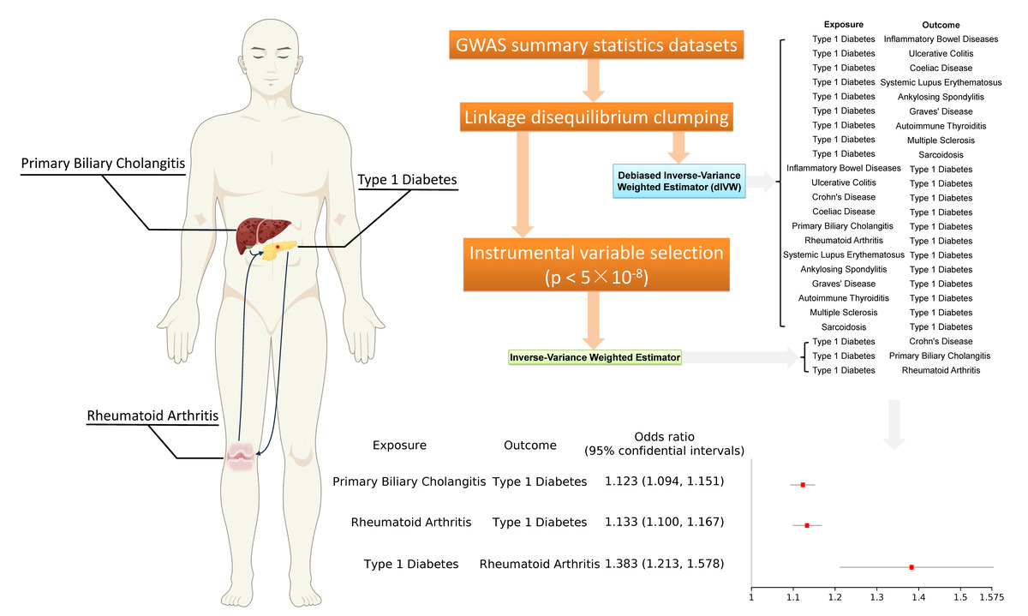

Bidirectional causal association between type 1 diabetes and autoimmune diseases: a Mendelian randomization study
DOI: 10.5114/aoms/200242
Notes:
Introduction
It has been reported that individuals with type 1 diabetes (T1D) are at a higher risk of concomitant occurrence of other autoimmune diseases (AIDs). Currently, there is a lack of research investigating the causal relationship between T1D and other AIDs. A comprehensive Mendelian randomization (MR) study was conducted using debiased inverse-variance weighted (dIVW) and inverse-variance weighted (IVW) estimators to examine the bidirectional causal relationship between T1D and 12 AIDs.
Material and methods
Genome-wide association study (GWAS) summary statistics datasets related to T1D or 12 AIDs were obtained from the FinnGen study or other published cohort studies. Pruned SNPs in linkage disequilibrium (LD)-clumped single-nucleotide polymorphisms (SNPs) were used as instrumental variables. For the dIVW analysis, no genome-wide significance threshold was applied for SNP selection.
Results
For each 1-unit increase in the log-transformed odds ratio (OR) of patients with primary biliary cholangitis (PBC) or rheumatoid arthritis (RA), the ORs of T1D were 1.123 (95% CI: 1.094–1.151) and 1.133 (95% CI: 1.100–1.167), respectively. Conversely, for each 1-unit increase in the log-transformed OR of T1D, the OR of RA was 1.383 (95% CI: 1.213–-1.578). No bidirectional associations were found between T1D and other AIDs.
Conclusions
Patients with RA or PBC have a higher risk of developing T1D, and those with T1D also have an increased risk of developing RA. These findings highlight the importance of regular screening for individuals with T1D, RA, or PBC.

