Slide 1
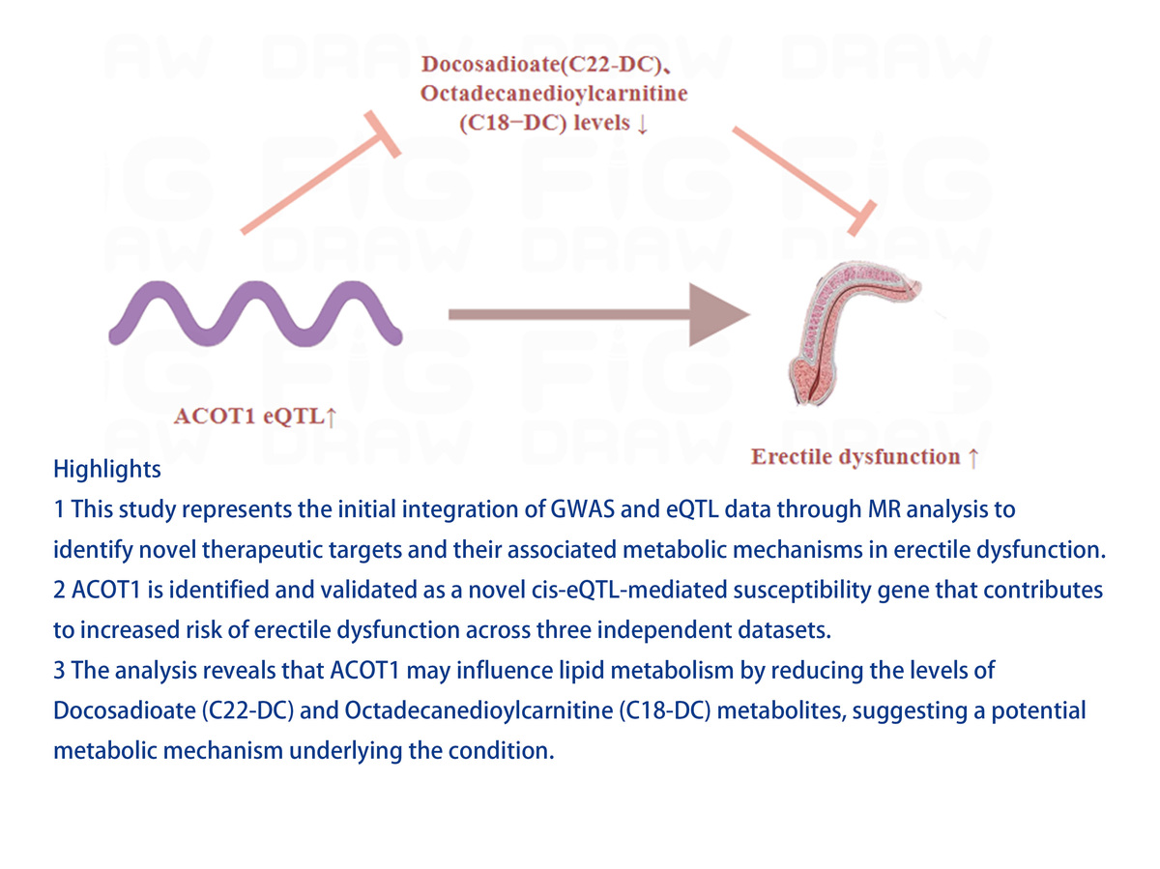

ACOT1 eQTL: a gene involved in lipid metabolism that modulates erectile dysfunction progression via metabolites
DOI: 10.5114/aoms/200393
Notes:
Introduction
The causal relationship between expression quantitative trait loci (eQTL) and erectile dysfunction (ED) remains underexplored. This study applied Mendelian randomization (MR) analysis to investigate potential causal links between novel susceptibility genes for ED and their underlying mechanisms.
Material and methods
Two-sample MR analysis was employed to examine causal connections between eQTLs, metabolites, and ED progression. Furthermore, summary-data-based MR (SMR) analysis was used to validate the causal association between cis-eQTLs and ED. A castrated rat model was also established to validate gene expression via quantitative real-time polymerase chain reaction (qRT-PCR).
Results
The results provide novel evidence that ACOT1 eQTL promoted ED progression. SMR analysis confirmed a causal relationship between the ACOT1 cis-eQTL and ED progression (p < 0.05). Regarding ACOT1’s potential role in ED, the study suggested that the ACOT1 eQTL may negatively regulate docosadioate (C22-DC) and octadecanedioylcarnitine (C18−DC), both of which inhibited ED progression. In SD rats, castration led to a decrease in the ratio of intracavernous pressure (ICP) to mean arterial pressure (MAP) and a reduction in smooth muscle to collagen, accompanied by an increase in -SMA expression in the castration group. These findings confirm the successful establishment of a castrated ED model. Additionally, further analysis of ACOT1 expression revealed significant upregulation in the castrated group (p < 0.05).
Conclusions
This study, for the first time, elucidates the mechanisms by which ACOT1, as a novel eQTL-mediated ED susceptibility gene, accelerates ED progression by negatively regulating levels of docosadioate (C22-DC) and octadecanedioylcarnitine (C18-DC) metabolites. These insights offer potential new therapeutic targets for ED.

